Slide 1
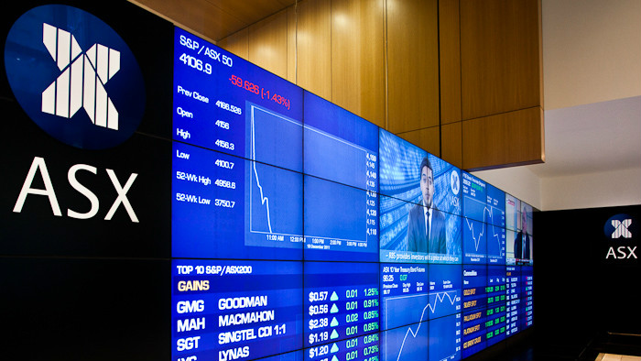
FIN 102 Group 5 Final Presentation
Australia Equities Market – The Lucky Country
6 April 2023
Dean Chua | Crystal Khoo | Meileang | Oliver Tan | Rukaiyaa | Shona Yap

Slide 2

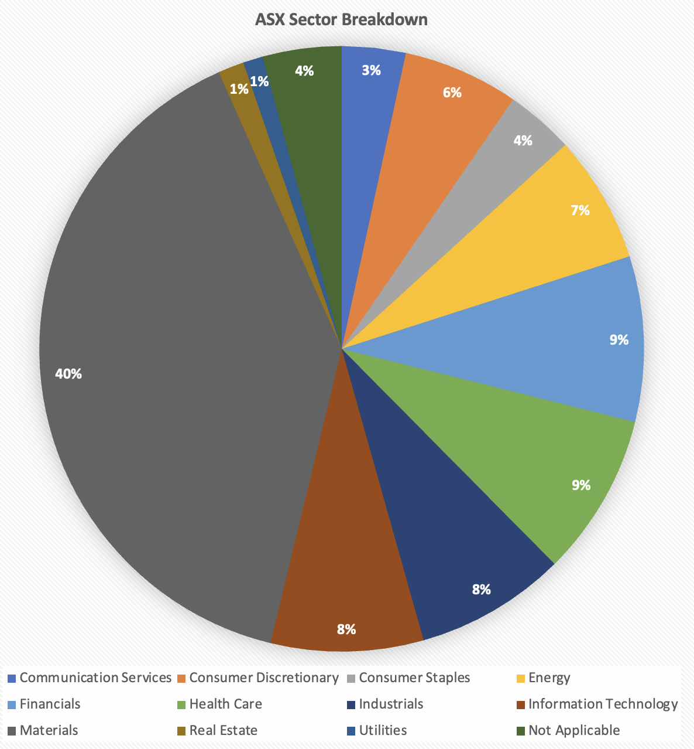



Introduction to Australia Securities Exchange (ASX)
Primer
Primary securities exchange platform in Australia
Market for trading equities, fixed income products, derivatives, and other financial instruments
Headquartered in Sydney & founded in July 2006
Among the top 10 listed exchange companies globally
Current Size: AUD2.7 Trillion, Separated into 11 GICS Sector; Materials Sector highest representation (40%)
Key Players
Reserve Bank of Australia (RBA)
Australian Prudential Regulation Authority (APRA)
Australian Securities and Investments Commission (ASIC)
Australian Treasury
Source: ASX
Introduction
Event I: 2008 GFC
Event II: Mining Boom
Event III: COVID-19
Event IV: Trade Tension
Outlook & Conclusion
Notes:
The Australia Securities Exchange (ASX) is Australia's primary securities exchange platform. It operates as a market for trading equities, fixed-income products, derivatives, and other financial instruments. It is headquartered in Sydney and is one of the oldest stock exchanges in the world. It was founded in July 2006 because of the merger of the Australian Stock Exchange and the Sydney Futures Exchange, and according to market capitalization, it is among the top 10 listed exchange companies globally (ASX, n.d.).
The ASX plays a crucial role in the Australian economy, providing investors access to various financial products and enabling companies to raise capital through equity and debt offerings. As of 21 March 2023, the ASX has 2085 listed companies with a combined market capitalization of around AUD 2.7 trillion, making it one of the largest exchanges in the Asia-Pacific region. The ASX market can be separated into 11 GICS Sectors (Appendix A). The materials sector has the highest representation, up to 40%, followed by the financials and healthcare sectors, which amount to 9% each.
Revolving around ASX, there are multiple key players including,
the Reserve Bank of Australia (RBA) which is Australia's central bank and is responsible for conducting monetary policy, issuing and managing the country's currency, and promoting financial stability.
Next, the Australian Prudential Regulation Authority (APRA), which is Australia's primary financial regulator responsible for regulating banks, insurance companies, and superannuation funds to ensure their safety and soundness. Thirdly, the Australian Securities and Investments Commission (ASIC), which is Australia's corporate, markets and financial services regulator. they ensure compliance with corporate and financial services laws, including market integrity and consumer protection.
Lastly, Australian Treasury, which is the department of the Australian Government responsible for economic policy development and implementation, including fiscal policy, tax policy, and financial sector regulation (IMF, 2019) .

Slide 3


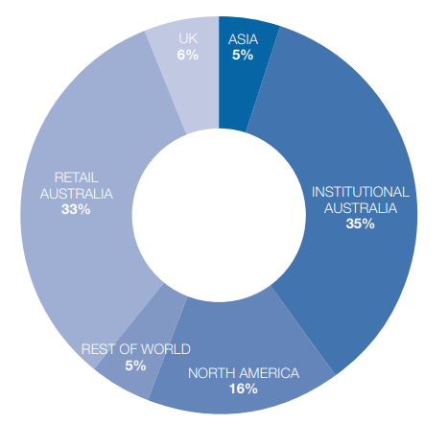
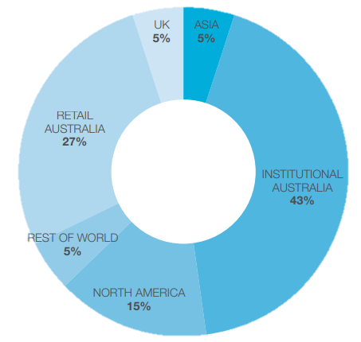


Introduction to Australia Securities Exchange (ASX)
Eligibility Criteria
The ASX market is comprised of various investors in the retail, domestic, and foreign sector
Incorporated under the Australian Corporations Act
Have at least 100 shareholders
Have a minimum of $4 million in net tangible assets
THE AVERAGE REGISTER BREAKUP
MARKET CAPITALIZATION DISTRIBUTION
68% of market capital is from Australia
35% of this is institutional investors
33% of this is retail investors
Australia holds the largest share of ASX 200 (70%)
43% is institutional investors
27% is held by retail investors
Structure and Size
North America holds the largest share outside of Australia (15%)
Meet certain financial performance standards:
Having a minimum operating profit of $500,000 in the last 12 months
Positive net profit after tax for the last three full financial years
Financial Performance
Comply with all legal and regulatory requirements, including environmental, occupational health and safety, and anti-corruption laws.
% Market Capital
% Issued Capital
Compliance
& More
Introduction
Event I: 2008 GFC
Event II: Mining Boom
Event III: COVID-19
Event IV: Trade Tension
Outlook & Conclusion
Notes:
To be publicly listed on ASX, companies must meet specific eligibility criteria outlined in the ASX Listing Rules. Some key criteria include: 1. Structure and Size: The company must be incorporated under the Australian Corporations Act, have at least 100 shareholders, and have a minimum of $4 million in net tangible assets. 2. Financial Performance: The company must meet specific financial performance standards, such as having a minimum operating profit of $500,000 in the last 12 months and a positive net profit after tax for the last three full financial years. 3. Compliance: The company must comply with all legal and regulatory requirements, including environmental, occupational health and safety, and anti-corruption laws (ASX, n.d.).

Slide 4
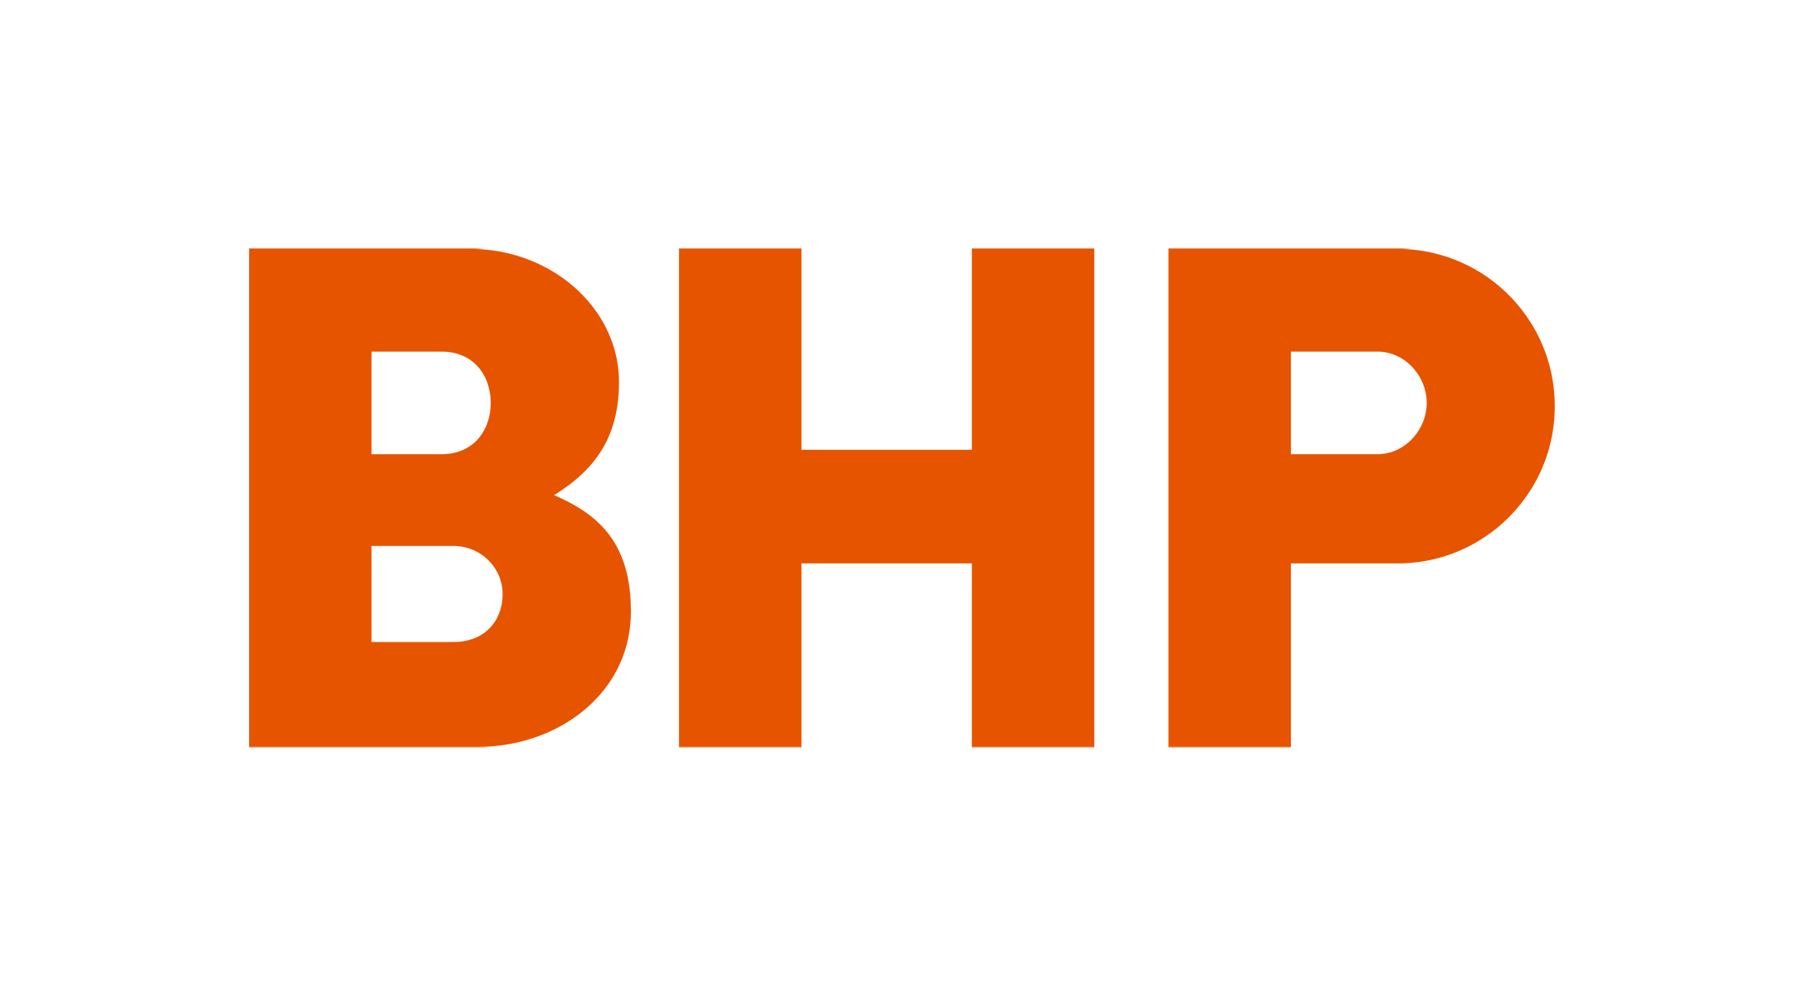




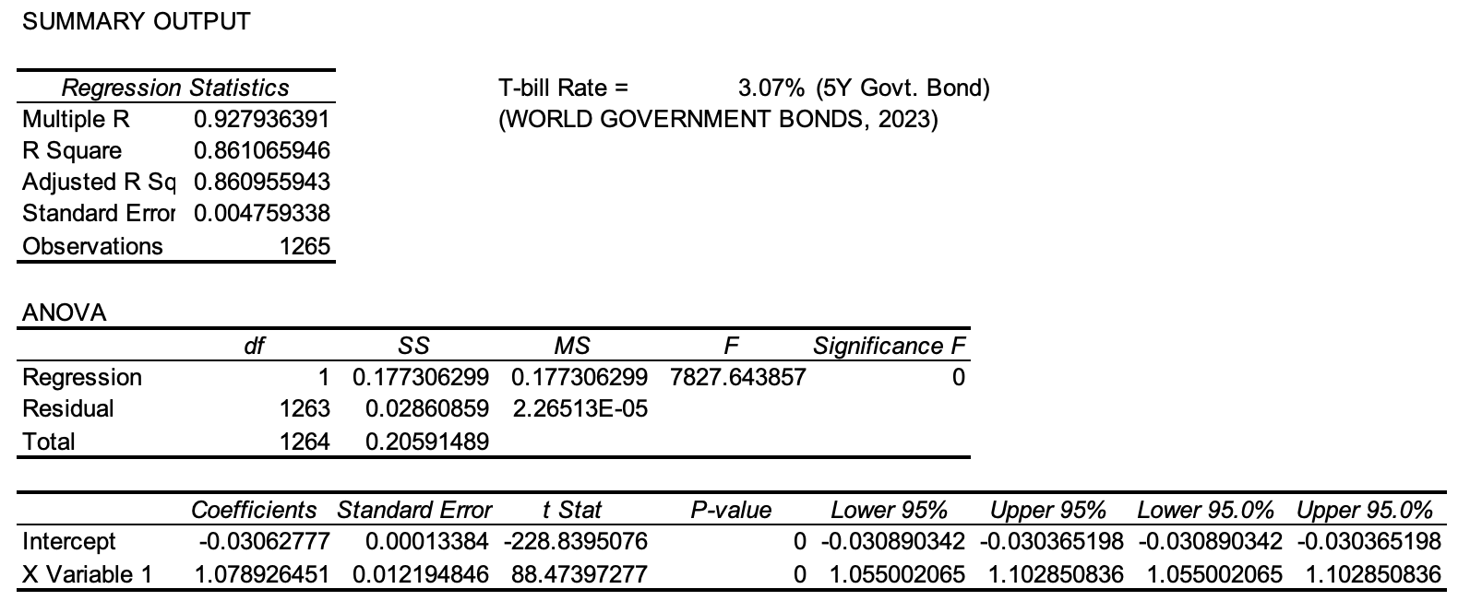
Single Index Model Analysis of Portfolio with ASX Market
Portfolio with Top 5 stocks of equal weightage
Others
T-bill rate = 3.07% (World Government Bonds, 2023)
Market returns from past 5 years
Stock returns from past 5 years
Correlation
86.11% of portfolio’s returns can be explained by the market
α
β
< 0.05
Introduction
Event I: 2008 GFC
Event II: Mining Boom
Event III: COVID-19
Event IV: Trade Tension
Outlook & Conclusion
Outlook & Conclusion
Notes:
Currently, the top 5 companies in the ASX are BHP Group Ltd, Commonwealth Bank of Australia, CSL Ltd, National Australia Bank Ltd and Westpac Banking Corporation.
We put these 5 established firms across the materials, financial, and healthcare sectors in.a portfolio with equal weightage and compared it with the ASX market returns. For our model, we used the t-bill rate of 3.07% and compared these stock returns from the past 5 years with the market returns from the past 5 years.
Analyzing our Single Index Model for Australia Securities Exchange results,
the correlation of this portfolio with ASX is 0.92794
and 86.11% of the portfolio's returns can be explained by the market, signaling that the regression line fits the actual data strongly.
The portfolio alpha (-0.03063) and beta (1.07893) are
both statistically significant since the p-value is less than 0.05.

Slide 5
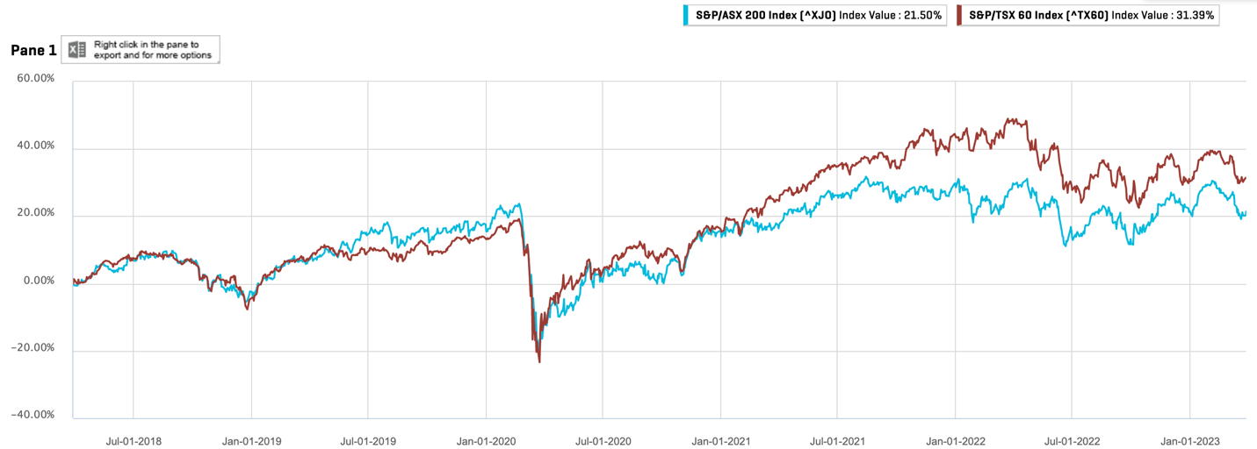
Comparing Historical Stock Prices for ASX200 Index against TSX60 Index
February 2020: Covid-19
December 2018: Global Trade War
Introduction
Event I: 2008 GFC
Event II: Mining Boom
Event III: COVID-19
Event IV: Trade Tension
Outlook & Conclusion
Notes:
Furthermore, we analysed the historical stock prices over a five-year period, starting from January 2018 to January 2023, to better understand the Australian Stock Exchange juxtaposed against the Toronto Stock Exchange (TSX).
The graph depicts the overall trends of both stocks, which move somewhat similarly.
A small dip around Dec 2018 due to global trade war which reduced economic activity
Both indexes experienced a stark decline in early 2020, which can be linked to Covid-19, where prices started to fall across all sectors, as policies were then put in place to cushion the impact of the pandemic (Johnson et al., 2022). However, both indexes were able to gradually recover as Australian banks claimed to have had their "best year" since 2013 post-pandemic (Garg, 2021), and the TSX200 was capable of rebounding through positive management, being able to navigate back to pre-Covid levels (Hugessen, 2021).
Overall in the past 3 years, TSX has been outperforming ASX, possibly due to several factors like: Sector Composition, Currency Fluctuations, Economic Conditions and Geopolitical Events. With Canada’s exposure to resources, the country has more cushion in instances of crashes in global commodity. The TSX is heavily weighted towards the energy and mining sectors, which may have performed relatively well during this period of recovery from the pandemic since these sectors would have seen a larger improvement post pandemic. On the other hand, the ASX has a larger exposure to the financial and healthcare sectors, which may have underperformed during this period. But on a broader scale, Australian global shares face a tighter monetary policy and are more impacted by the slump in commodity prices than TSX.

Slide 6
Major Events
Historical to Present day

Slide 7
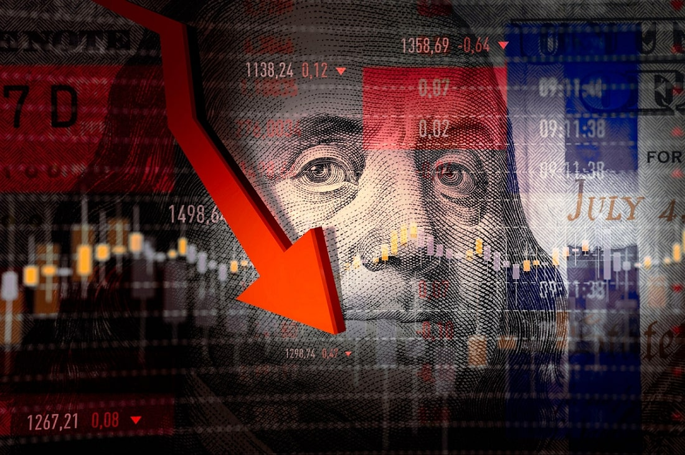
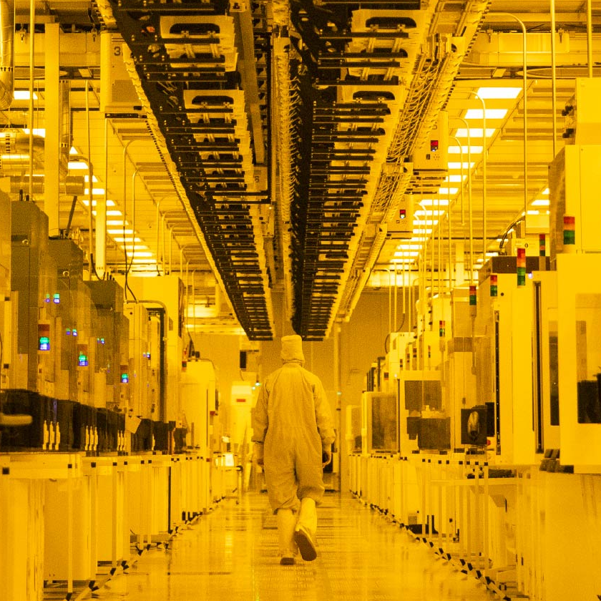
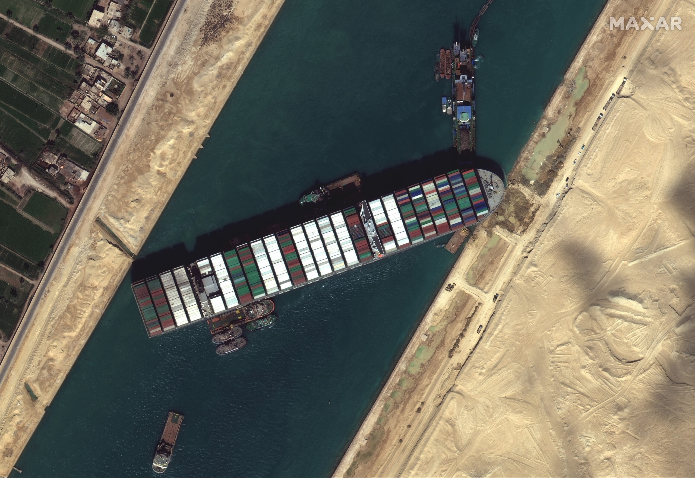
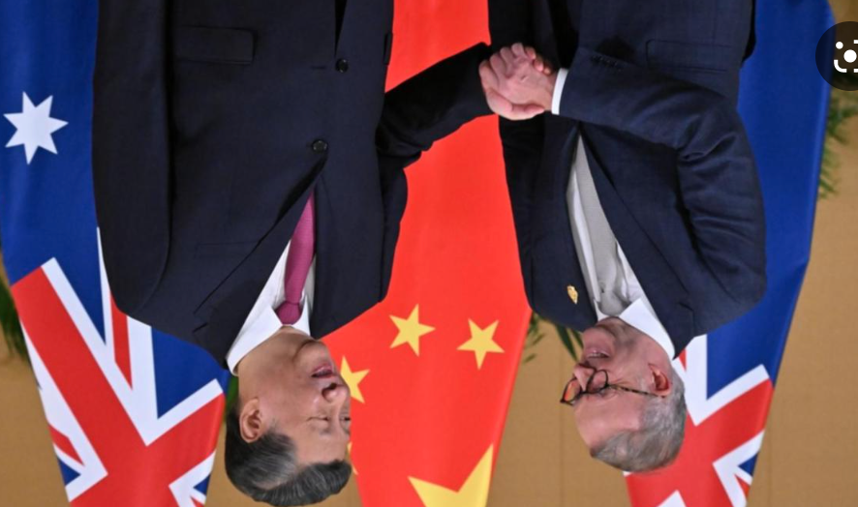
Overview of Major Events that have impacted the AU Equities Market
Global Financial Crisis
(2008)
COVID-19
(2019)
The most serious financial crisis since the Great Depression
Global pandemic affecting all economies
2008
2023
2000s Mining Boom & 2021 China RE Crisis
Au-China Trade Tensions
(2018-2022)
Relation to AU commodities prices and export demands
Threatening AU’s high dependence on China’s import demand

Slide 8
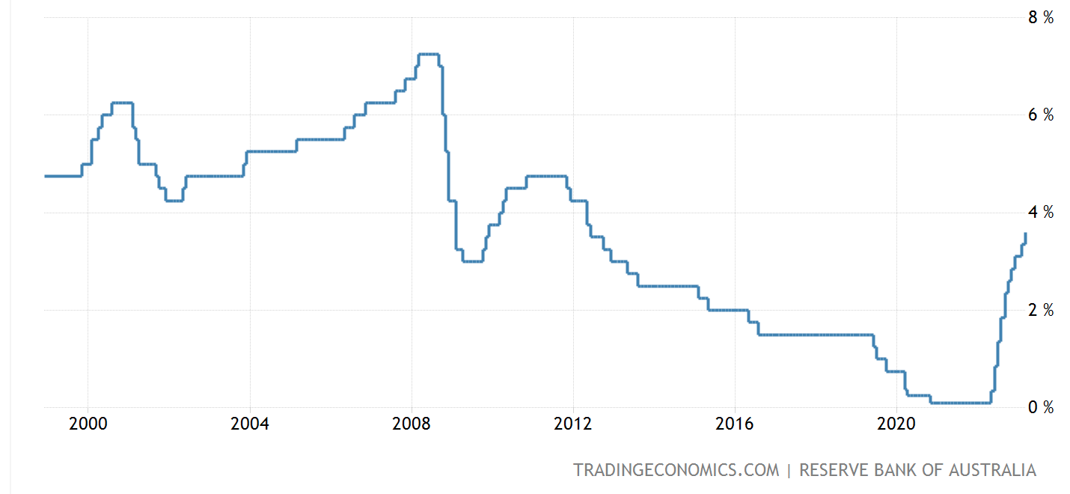




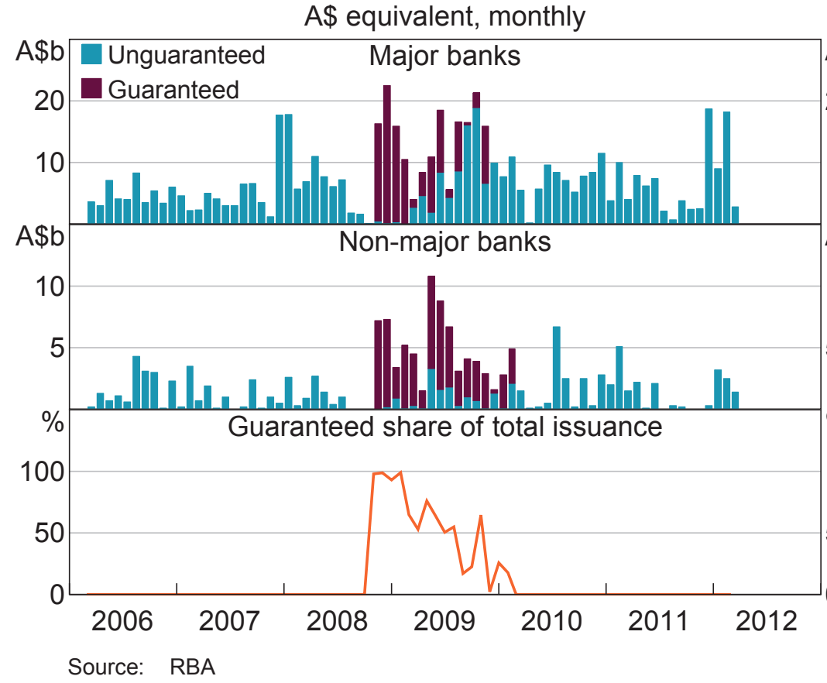
2008 Global Financial Crisis: AUS Government’s Response & Measures the RBA undertook
Interest-Rate Cuts
Quantitative Easing
Drastic reduction in interest rates by 100 basis points on 7 October 2008, cash rate dropped from 7% to 3.25% in order to stimulate demand
Allowing banks to swap out risky mortgage debts for secure government bonds to maintain liquidity of the banks and for banks to continue lending to borrowers to facilitate short-term refinancing
RBA buys long-term securities
Increases money supply, lowers I/R
Allows banks to lend & to borrow
Australian Guarantee Scheme
Fiscal Stimulus Package
Raised the ceiling for the guarantee on loans of up to $1 million to facilitate the flow of credit
To alleviate the contraction in private spending and support families. Injected $10.4 billion in Oct 2008 and a further $42 billion in Feb 2009
Others
Housing Construction
$52.4B stimulus
package
Cash bonuses to
pensioners & low-income
Infrastructure Projects
Introduction
Event I: 2008 GFC
Event II: Mining Boom
Event III: COVID-19
Event IV: Trade Tension
Outlook & Conclusion
Notes:
Buy long term securities to boost the economy allows banks to lend and people to borrow

Slide 9
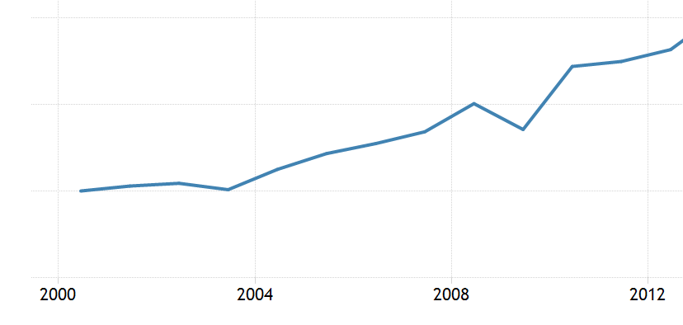
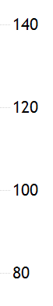
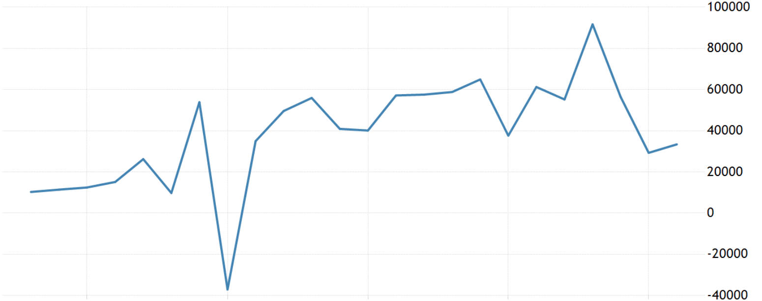
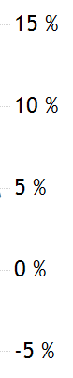
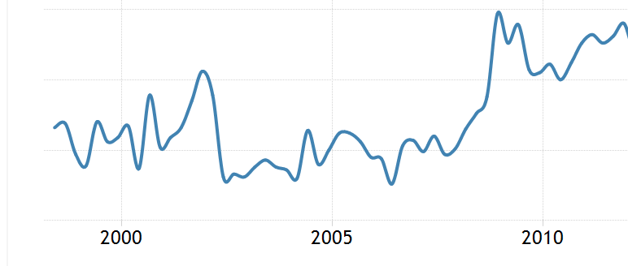
Impact on AU Equities & Economy: Spillover effects of the GFC despite prompt Government’s intervention
Immediate Impact
Market’s Reaction
Market Sentiments
Exports & AUD
Reduction in the demand for AU’s exports: Fell by $27.4B or 12.2%
AUD fell from $0.98 in July 2008 to $0.60 in Oct 2008
AUS Export Volume Index (2000=100)
1
ASX 200 Index (Nov 2007– Mar 2009)
-53.90%
2
Collapse in
Capital Flows
Esp. in Private Foreign Investments
Volatility in capital flows due to increased risk aversion and ‘home biasness’ amongst investors
Market Cap.
(Nov 2007– Mar 2009)
-19%
3
PE/Ratio
(Jan 2007 – Jan 2008)
Consumer &
Business Confidence
Due to pessimistic outlook for US economy
Contraction in household consumption, dramatic increase in savings rates
AUS Household Savings Ratio (%)
-52.69%
4
U/E Rate
(Feb 2008 – Aug 2009)
4.1% 5.8%
Introduction
Event I: 2008 GFC
Event II: Mining Boom
Event III: COVID-19
Event IV: Trade Tension
Outlook & Conclusion

Slide 10
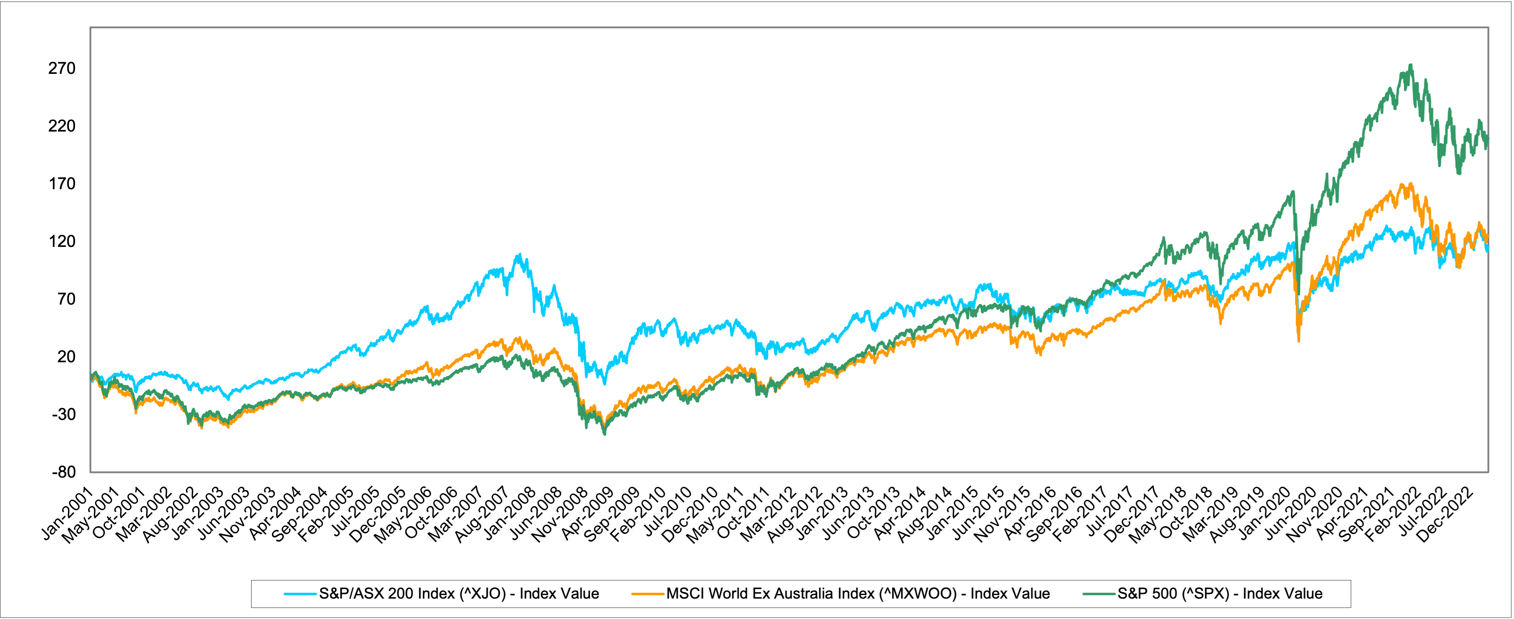
Yet, why was the AUS Economy still Resilient? AUS did not experience a technical recession during the 2008 GFC
Outperformance of the ASX200 as compared to other economies in 2008
ASX 200
MSCI World Ex AUS Index
S&P500
1
2
3
Small exposure to risky assets: US housing market & US banks securities
Higher lending standards imposed by the APRA
China’s demand for AU’s commodities exports as part of their Fiscal Stimulus
Introduction
Event I: 2008 GFC
Event II: Mining Boom
Event III: COVID-19
Event IV: Trade Tension
Outlook & Conclusion

Slide 11
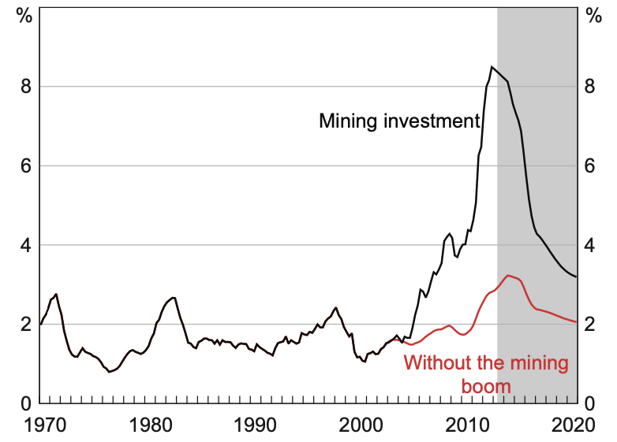
Mining Boom: China was a Significant Player in the 2000-2010s Australia Mining Boom
The mining market is strong enough to recover through headwinds from the financial crisis
Reasons for the Boom
Global Market Share from 2000 to 2010
China was going through industrialization in 2000 and required a lot of raw resources to build and manufacture.
This caused iron ore exports to grow an average of 23% from 1999 to 2011. Mining had doubled its GDP share.
As many mining companies rushed to increase output to sell to China, this triggered a huge influx of investments.
Australia | Price Growth Rate % |  | Share of Total Export Value %
Type | 2000 | 2010 | 2000 | 2010
Coal | -1% | 10% | 6% | 15%
Iron Ore | 2% | 15% | 3% | 17%
Other Ore | - | 9% | 6% | 8%
Metal | - | 5% | 10% | 7%
Total | 1% | 9% | 35% | 55%
Increased in Mining Investments in AUS
Ore prices from 2000 to 2011
USD per dry metric to unit
+ 437%
2008 Financial Crisis
Sources: RBA, Statista, Geo-Science Australia
Introduction
Event I: 2008 GFC
Event II: Mining Boom
Event III: COVID-19
Event IV: Trade Tension
Outlook & Conclusion
Notes:
https://www.rba.gov.au/publications/bulletin/2014/dec/pdf/bu-1214-3.pdf
https://www.rba.gov.au/publications/confs/2011/kearns-lowe.html
https://www.rba.gov.au/publications/rdp/2011/2011-08/aus-mining-industry.html

Slide 12
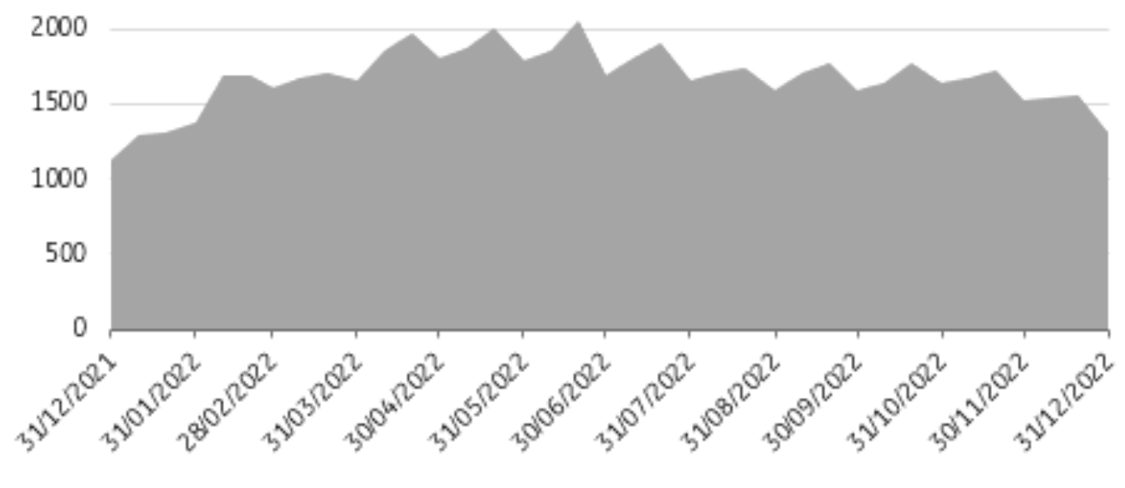
China’s 2021 Evergrande Property Market Collapse Affected Australia Largely
Reason for the Collapse
This collapse decreased the demand for steel rebar and hence demand for iron ore
Evergrande is one of China's largest property developers. Due to its massive debt burden, the company has been facing financial difficulties.
When the company defaulted on its debt obligations and entered bankruptcy proceedings, this led to a steep decline in demand for commodities such as metals, concrete, and copper used in infrastructure projects.
Construction Sector Growth Rate
Real-Estate Sector Growth Rate
Overall GDP increase from 2018 - 2023
10-Day Inventory of Steel Mill slumps
Decreased by 18% compared to the previous year
USD per dry metric to unit
- 25%
Sources: AFR, The Guardian, CNN, National Bureau of Statistics
ORE PRICES FROM 2012 TO 2022
Introduction
Event I: 2008 GFC
Event II: Mining Boom
Event III: COVID-19
Event IV: Trade Tension
Outlook & Conclusion
Notes:
https://www.afr.com/policy/economy/the-china-effect-how-the-resources-boom-galvanised-australia-20220321-p5a6dm
https://www.theguardian.com/commentisfree/2022/may/31/the-sheer-size-of-the-china-trading-relationship-is-why-australia-has-to-share-its-feasts-and-famines-with-beijing
https://edition.cnn.com/2023/01/16/business/china-gdp-2022-hnk-intl/index.html
National Bureau of Statistics

Slide 13
Overview of China’s Exports and AU’s relative importance
Though China mined its own resources, they still have to import from neighboring countries
Natural Resources Mined in China
China Imports 2022
Type | Producer | Global Demand %
Coal | Largest producer and consumer | 50%
Iron Ore | Largest producer and Consumer | 70%
Zinc | Largest producer | 50%
Gold | Largest producer | -
Copper | 2nd largest producer | 50%
Lead | Largest producer | 40%
Tin | Largest Producer | -
Tungsten | Largest Producer | -
Nickel | Largest Producer | 60%
Rare Elements | Largest Producer | -
Total China Imports: USD 2.72t
Commodities % of imports: 13.3%
Total Value of
Commodities
Imported:
USD 362B
Countries China import from 2022
LAMEA
Asia - Pacific
Chile
Top 3 Countries
Imported from
for Iron Ore
Top 3 Countries
Imported from
for Minerals
Brazil
Australia
Australia
Sources: MNR, World-Bank, Commodity
Introduction
Event I: 2008 GFC
Event II: Mining Boom
Event III: COVID-19
Event IV: Trade Tension
Outlook & Conclusion
Notes:
https://commodity.com/data/china/
https://wits.worldbank.org/CountryProfile/en/Country/CHN/Year/2020/TradeFlow/Import/Partner/all/Product/Fuels
https://www.mnr.gov.cn/sj/sjfw/kc_19263/zgkczybg/202010/P020201022612392451059.pdf - 2020

Slide 14
China’s Demands for Natural Resources
There is a large demand for metals, energy, and steel for the top 3 largest sectors in China
GDP Segments by Industry
Largest Segments that require Resources
Construction: China has a large construction industry, requiring large amounts of raw materials such as metals, cement admixtures, concrete, and wood.
Manufacturing: China has a large manufacturing industry of goods there is a large requirement for raw materials such as copper, zinc, iron ore, and nickel to produce a wide range of products.
Energy: China is the world's largest energy consumer, and it requires raw materials such as LNG, coal, and uranium to fuel its electricity production.
Breakdown on the type of Resource each Industry require
Manufacturing | % Resource Demand
Metals | 30 – 40%
Energy Resources | 20 – 30%
Chemicals | 10-20%
Agricultural Products | 5-10%
Wood | 5-10%
Industrials | % Resource Demand
Cement | 60 – 70%
Steel | 20 – 30%
Sand and Gravel | 5 – 10%
Wood | 1 – 5%
Real-Estate | % Resource Demand
Cement | 50 – 60%
Steel | 20 – 30%
Sand and Gravel | 5 – 10%
Wood | 5-10%
Sources: Statista, Australia Bureau of Statistics
Introduction
Event I: 2008 GFC
Event II: Mining Boom
Event III: COVID-19
Event IV: Trade Tension
Outlook & Conclusion
Notes:
Statista
Australian Bureau of Statistics

Slide 15
How Does The China Market Relate to The Australian Market
15
China and Australia are strong trading partners that mostly trade on natural resources
Value of AUS Exports to China’s Growth
Strong Import – Export Partners 2020
Exports to China is c. 33% of
total Australia Exports
Total Value of
Exports to China:
USD 102B
Consistent YOY growth rate in Australian exports to China
Current relationship between Australia and China have worsened due to an investigation into the initial spread of the COVID-19 pandemic
This has led to tensions and tariffs that China imposed on Australian agricultural exports.
This resulted in a slow growth from 2020 to 2022 on average of 1% growth over 3 years.
Australia is a major supplier of commodities such as iron ore, coal and natural gas to China.
These commodities are used largely in the construction and manufacturing industries in China, these are key economic drivers of China.
Sources: Australia Bureau of Statistics, OEC, VIU, The Guardian
Introduction
Event I: 2008 GFC
Event II: Mining Boom
Event III: COVID-19
Event IV: Trade Tension
Outlook & Conclusion
Notes:
Australia Bureau of Statistics
https://oec.world/en/profile/bilateral-country/chn/partner/aus
VIU
https://www.theguardian.com/commentisfree/2022/may/31/the-sheer-size-of-the-china-trading-relationship-is-why-australia-has-to-share-its-feasts-and-famines-with-beijing

Slide 16
Impact of China on Australia
China has grown the mining market to a point where Australia is highly dependent on its market
Created a larger Mining Market in AUS
HIGH FDI INTO AUS MINING MARKET
Exports Share % | Breakdown In 2000
China | 5.5%
Japan | 39.9%
South Korea | 15.6%
Europe | 3.3%
USA | 6.1%
Others | 25%
Breakdown In 2020
48.4%
13.5%
11.3%
3.1%
-
11.9%
Growth Rate
+ 42.9%
- 26.4%
- 4.3%
- 0.2%
- 6.1%
- 13.1%
AUD million
Total investments into Australia
between 2008 and 2020 is AUD 21.6b
Market volume grew from 200 million tonnes in 2000 to 900 million tonnes 2020
NON-DIVERSIFIED BUYERS RISK
CURRENCY RISK (COMMODITIES FLUCTUATION)
Australia's heavy reliance on exports to China could pose a significant economic risk.
Many of Australia's exports to China are concentrated in a few key industries, such as iron ore, coal, and LNG.
The Australian economy is heavily reliant on commodity prices, and fluctuations in these prices can significantly impact the country's currency.
Sources: AFR, Statista
Introduction
Event I: 2008 GFC
Event II: Mining Boom
Event III: COVID-19
Event IV: Trade Tension
Outlook & Conclusion
Notes:
https://www.afr.com/policy/economy/the-china-effect-how-the-resources-boom-galvanised-australia-20220321-p5a6dm
Australia has sought to diversify its export markets and reduce its reliance on China. This includes efforts to expand trade relationships with other countries in the Asia-Pacific region and investments in industries such as renewable energy and advanced manufacturing.
When commodity prices are high, trade improves, meaning the country can purchase more goods and services from other countries for the same number of exports with an increased demand for the Australian dollar, resulting in the currency's appreciation.

Slide 17
How are Australian Resources-Based Equities affected?
AUS Equities are sensitive to demand and supply shocks from the commodities market
Supply Shocks
Demand Shocks
In May 2021, the iron ore price decreased because of a series of supply shocks.
China's restricted steel output to reduce carbon emissions, which led to a reduction in demand for iron ore.
A Covid-19 outbreak in a key region in China that produces iron ore
This caused supply chain disruptions due to a fall in demand, and coupled with an increase in supply from Brazil had caused the stock prices of BHP, Rio Tinto, and Fortescue Metals Group to decrease.
In 2020, China placed taxes on Australian wine, barley, and beef imports due to political tensions.
China started to restrict its imports of Australian liquefied natural gas.
This led to a decline in demand for Australian LNG producers such as Woodside Petroleum and Santos; hence the stock prices of these companies have decreased.
Sources: BBC, ING
Introduction
Event I: 2008 GFC
Event II: Mining Boom
Event III: COVID-19
Event IV: Trade Tension
Outlook & Conclusion

Slide 18
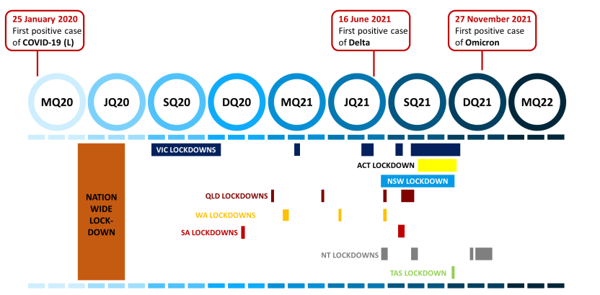
COVID-19 Pandemic Overview
Overview of the COVID-19 Pandemic
The outbreak of COVID-19 impacted the global economy to an extent last seen during the Global Financial Crisis of 2008.
Australia recorded its first COVID-19 case on 25 January, resulting in a nationwide lockdown that would last over 3 months, and regional lockdowns occurred due to outbreaks and the introduction of the Delta and Omicron Variants.
Introduction
Event I: 2008 GFC
Event II: Mining Boom
Event III: COVID-19
Event IV: Trade Tension
Outlook & Conclusion
Outlook & Conclusion

Slide 19
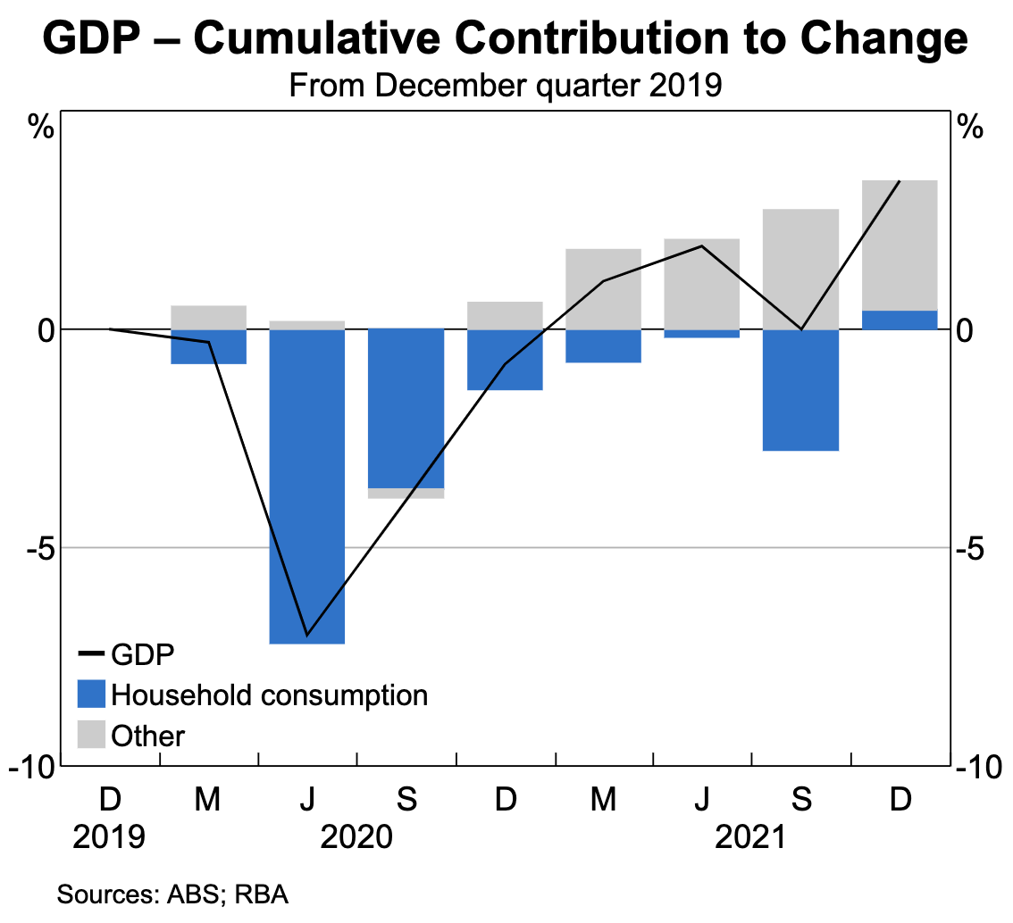
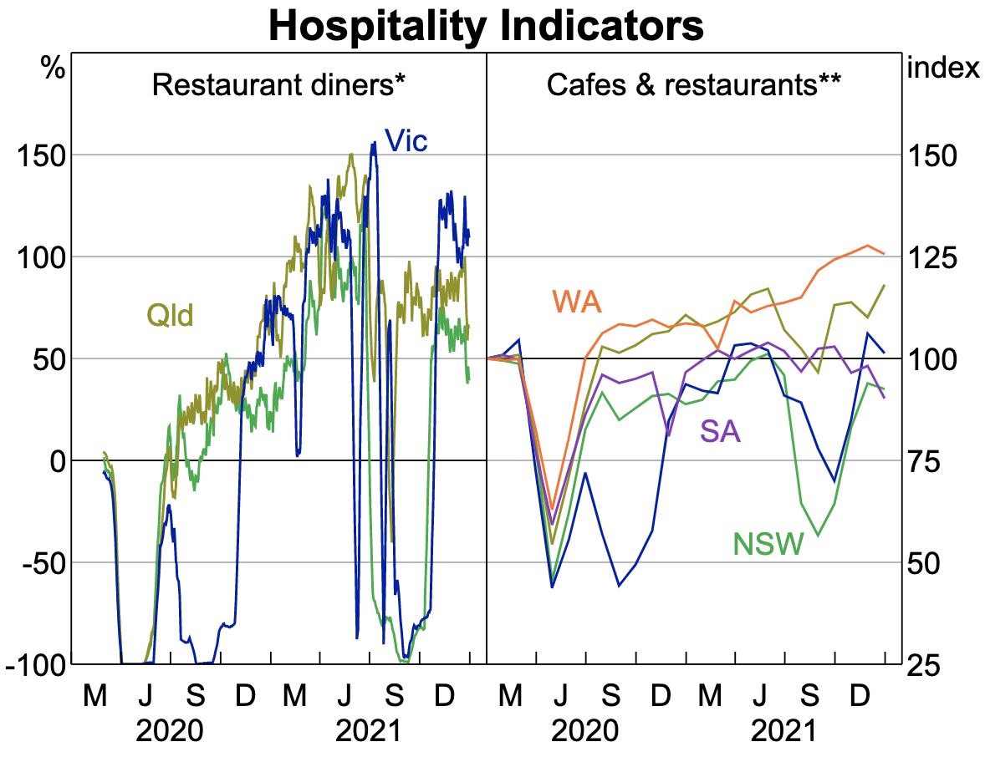
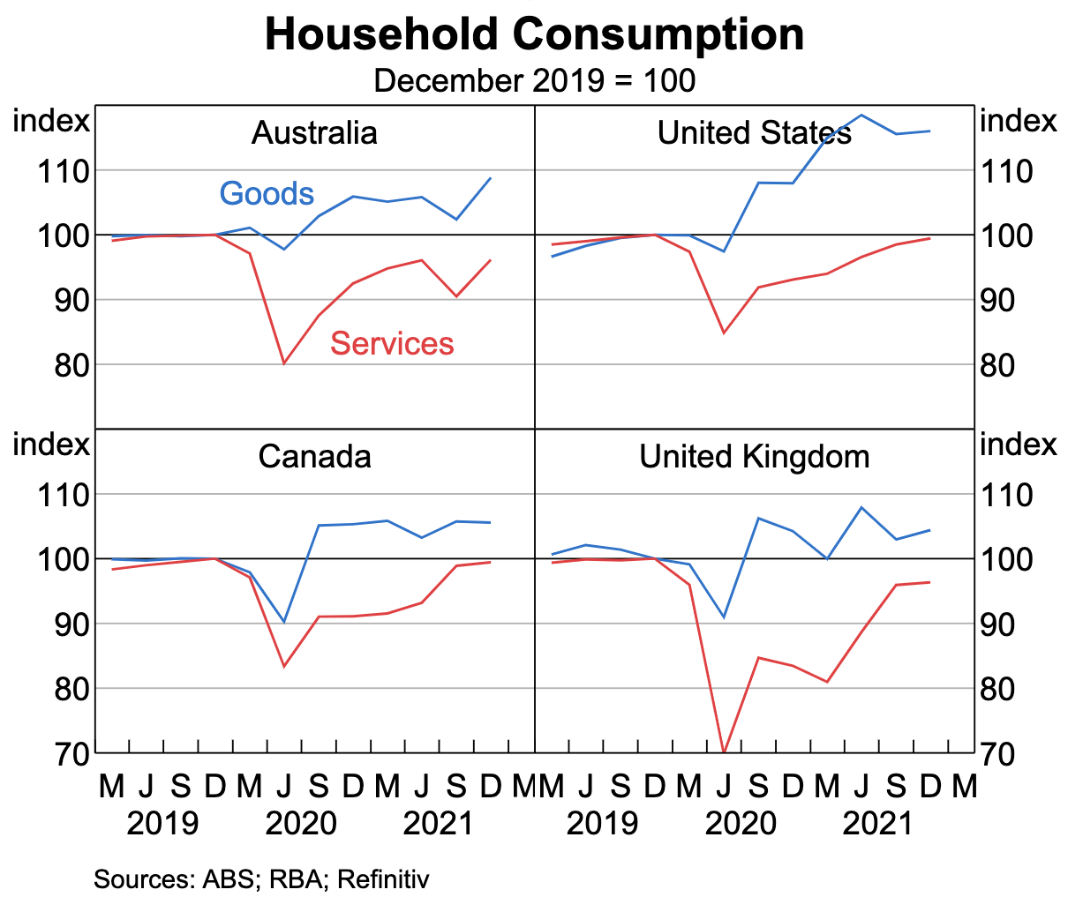
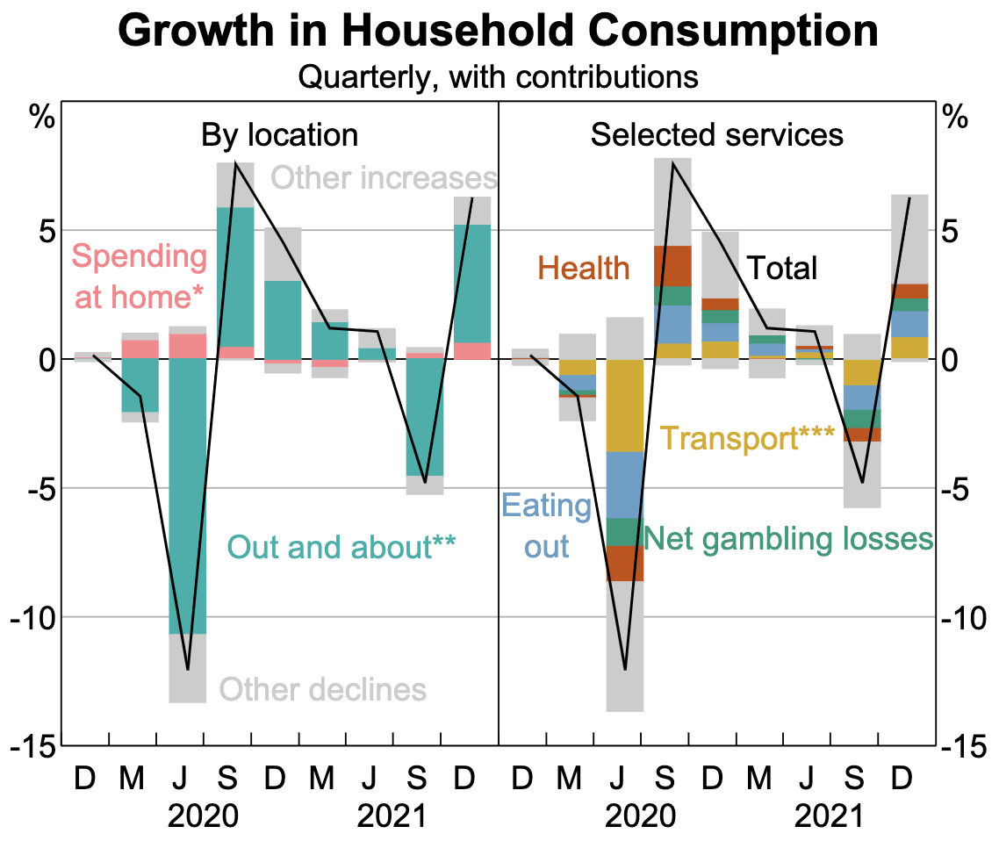
COVID-19 Pandemic Economic Impacts
GDP
GDP decreased by about 7% while consumption expenditure dropped by 12.5% during the quarter of June 2020.
Various sectors including trading, tourism and hospitality sectors took major hits that affected Australian GDP.
Government Policies dampened the impact compared to other countries.
Introduction
Event I: 2008 GFC
Event II: Mining Boom
Event III: COVID-19
Event IV: Trade Tension
Outlook & Conclusion

Slide 20
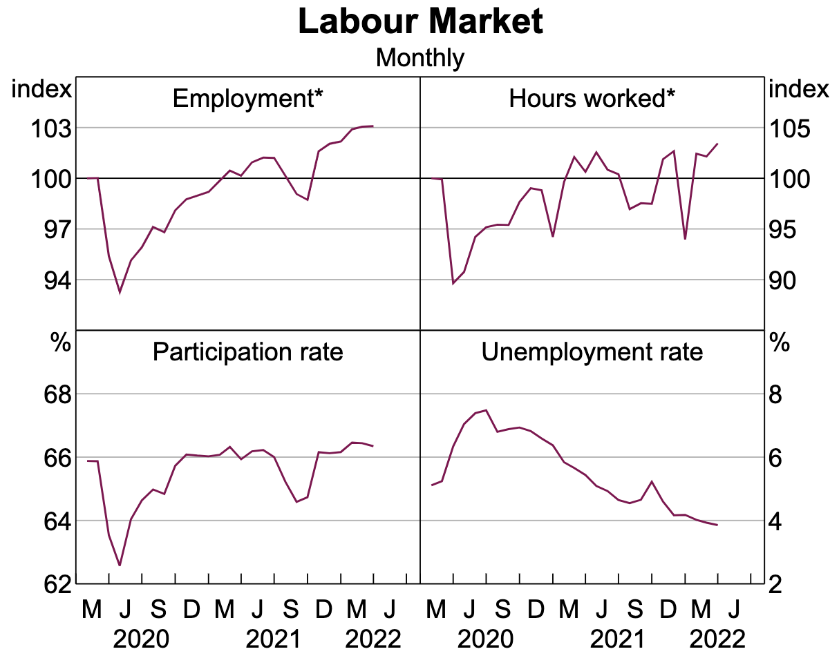
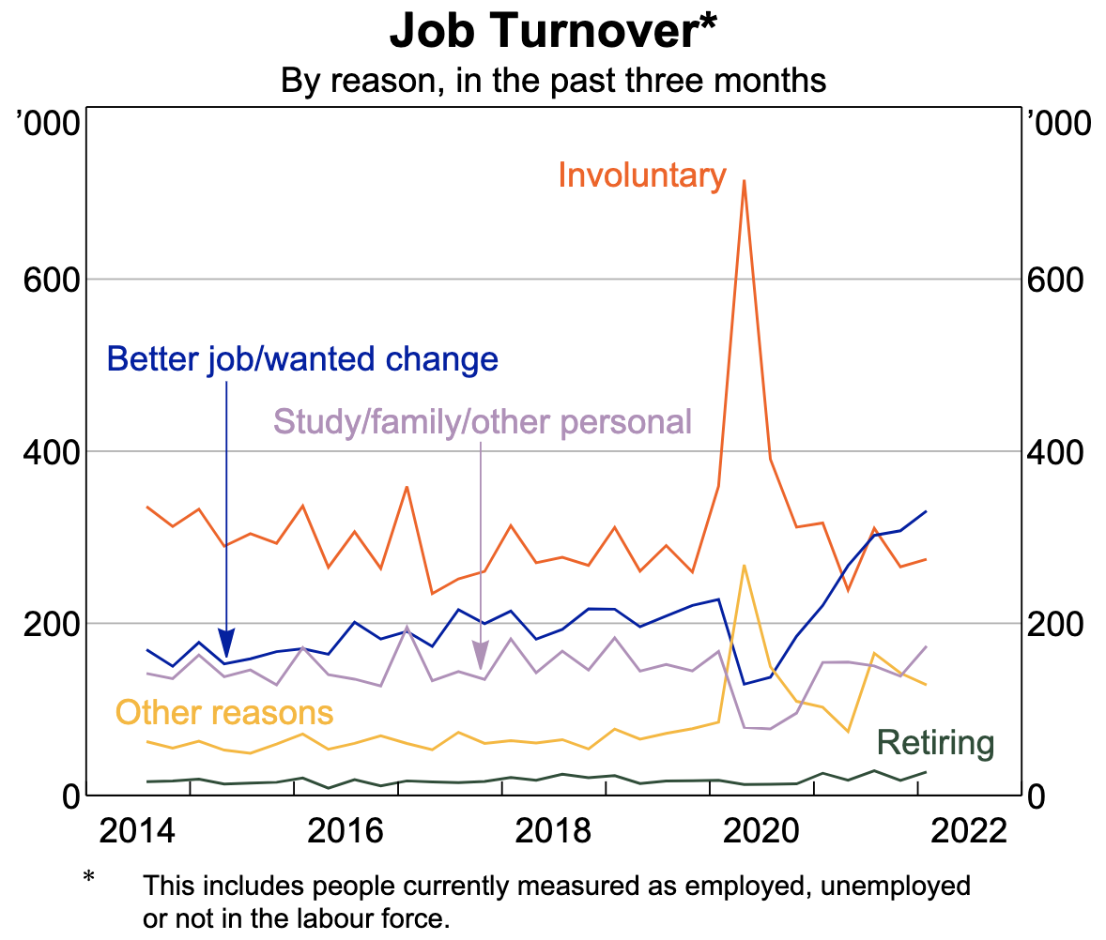
COVID-19 Pandemic Economic Impacts
Unemployment Rates
Unemployment rates rose from 5.7% in March 2020 to 7.4% in June 2020, resulting a net loss of approximately 871,000 jobs.
Approximately 371,000 of jobs lost came from the hospitality sector, as tourism and domestic businesses temporarily closed due to lockdowns and social distancing for the first few months.
Labour Market Indicators
Introduction
Event I: 2008 GFC
Event II: Mining Boom
Event III: COVID-19
Event IV: Trade Tension
Outlook & Conclusion

Slide 21
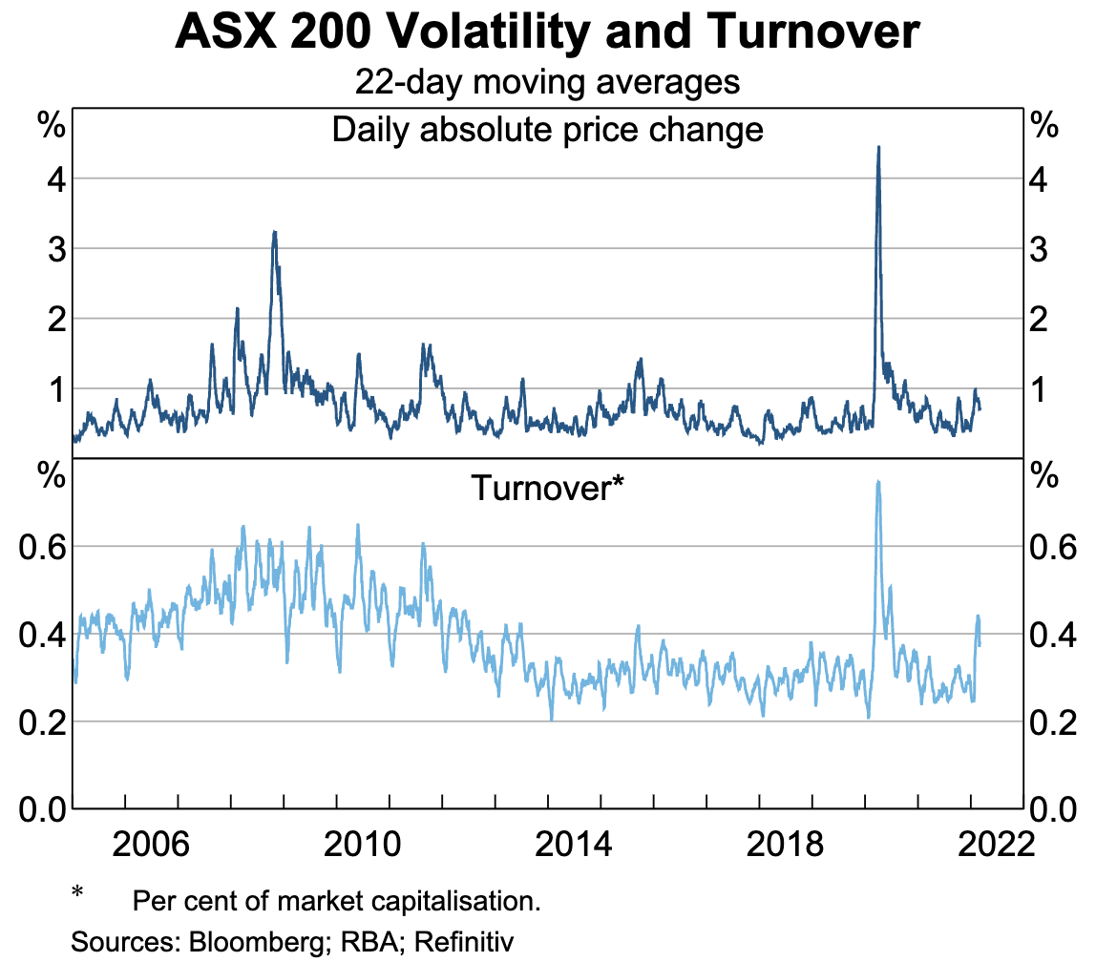
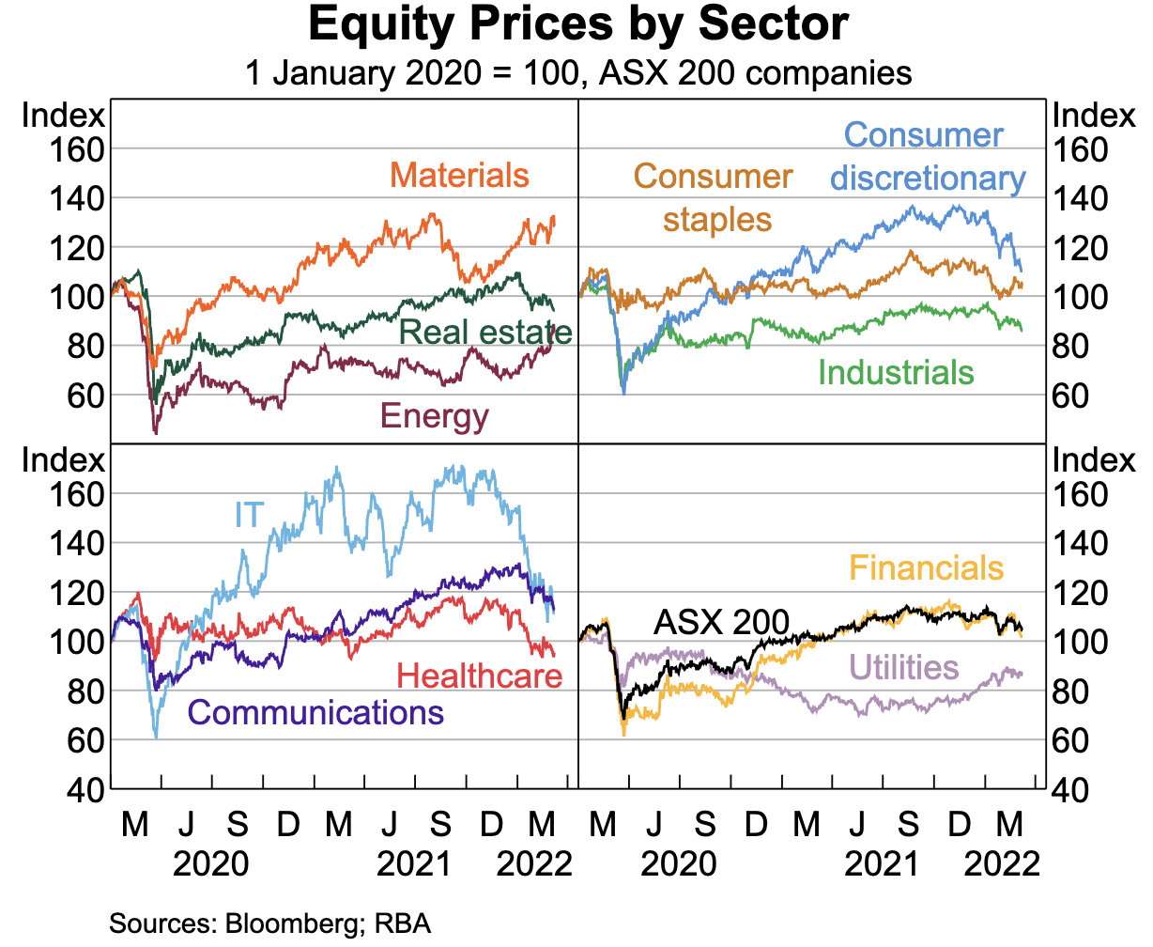
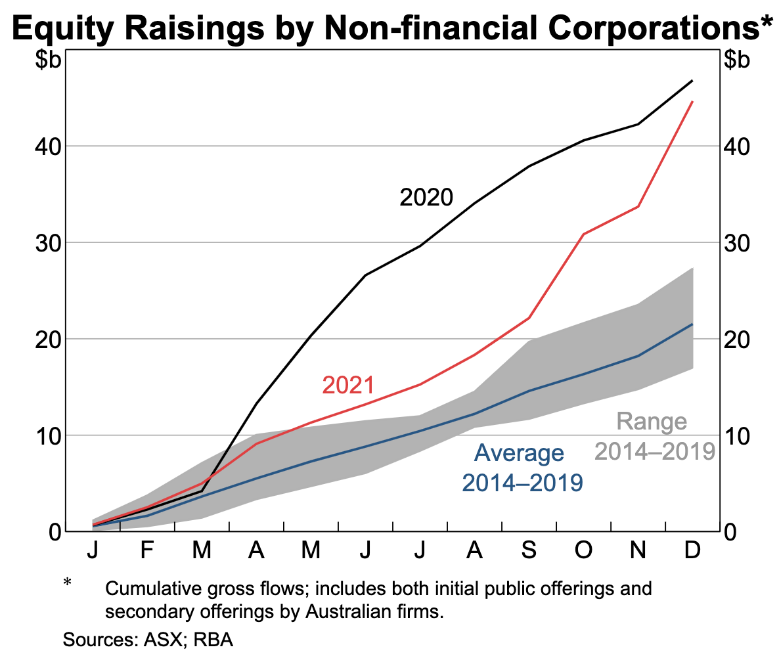
COVID-19 Pandemic Impact on Equity Markets
ASX 200 and Other Equities
S&P/ASX200 Index dropped by 35% below its peak in February 2020
Equity Prices became volatile, as daily absolute price change quadrupled
Equity Turnover Rates increased as Investor Confidence decreased
Listed Firms had large volumes of equity raisings compared to IPOs
Introduction
Event I: 2008 GFC
Event II: Mining Boom
Event III: COVID-19
Event IV: Trade Tension
Outlook & Conclusion

Slide 22
Government Responses
Government Response | Purpose
Economic Stimulus Packages | Economic Stimulus Package of approximately A$314 billion to directly support Australian Households
Tax Debt Reliefs and Subsidies | Redirect tax money into the economy to boost domestic consumption and maintain the GDP.
JobSeeker Wage Subsidies and Supplement Schemes | Help maintain employment levels and business payrolls Estimated A$89 billion distributed to companies by the end of March 2020
Insolvency Reliefs | Measures were put in place to protect and restructure the liquidation of small businesses, especially given the pause in domestic business.
Access to Superannuation | Allowed individuals and sole traders to access Superannuations up to $20,000.
Introduction
Event I: 2008 GFC
Event II: Mining Boom
Event III: COVID-19
Event IV: Trade Tension
Outlook & Conclusion
Notes:
Superannuation is basically Australia CPF

Slide 23
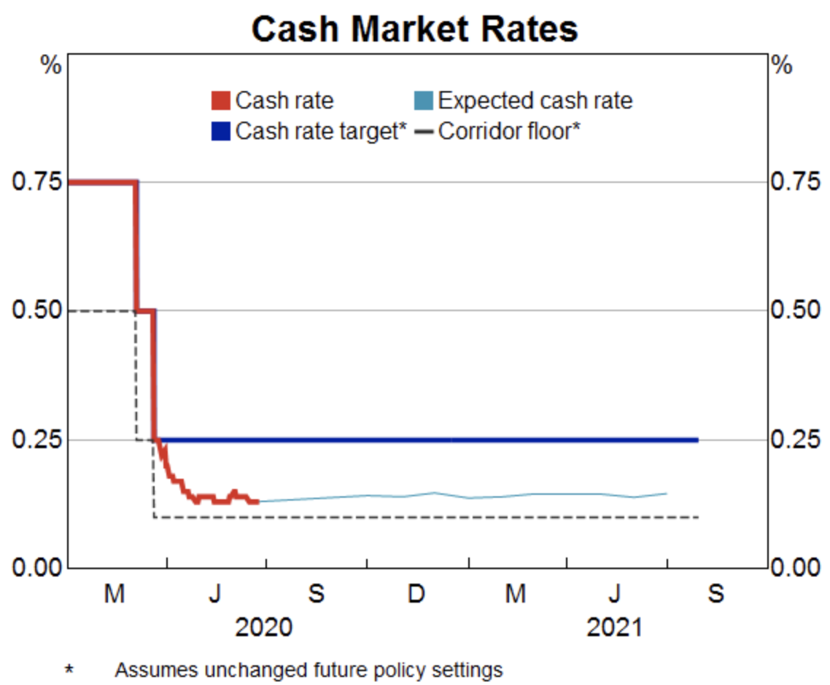
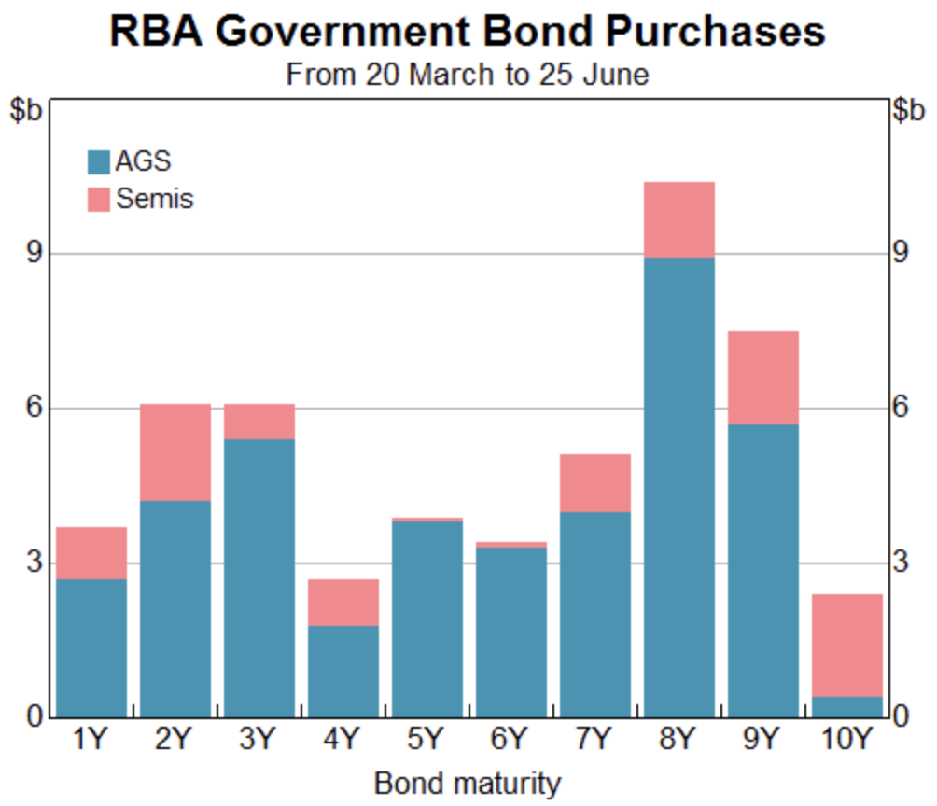
Reserve Bank of Australia Responses
Cash Market Rates
Purchasing of Government Bonds
The cash rate dropped to 0.25% in March 2020 around the announcement of lockdown and further decreased to 0.1% in November 2020.
RBA announced A$100 billion worth of secondary market government bond purchases to maintain financial institutions.
Others
RBA announced A$90 billion term funding facility to give banks access to 3-year funding at 25 basis points to support credit provision
RBA conducted longer repurchase agreements and broadened the range of eligible collateral to ensure market liquidity.
Introduction
Event I: 2008 GFC
Event II: Mining Boom
Event III: COVID-19
Event IV: Trade Tension
Outlook & Conclusion
Notes:
Debelle, G. (2020, June 30). The Reserve Bank's Policy Actions and Balance Sheet. Reserve Bank of Australia. https://www.rba.gov.au/speeches/2020/sp-dg-2020-06-30.html

Slide 24
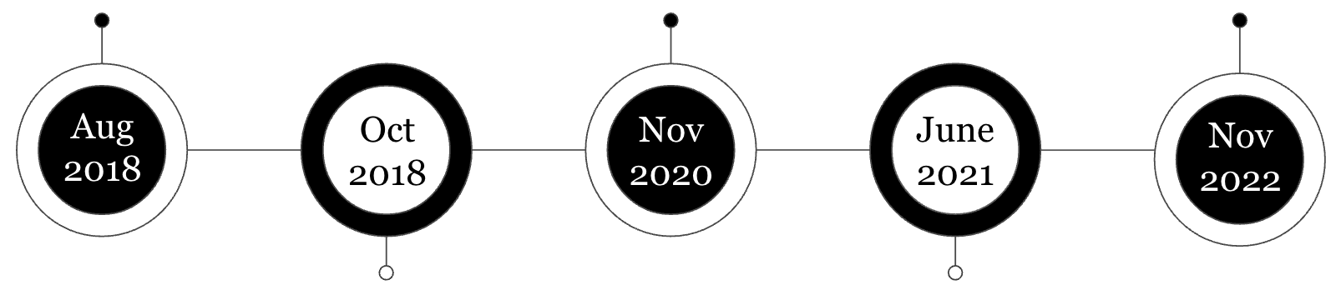
2018-2022 Australia - China Trade Tension: Overview and Timeline
China’s One-sided sanctions on Australian Export
Trade war started when Australian government banned “Huawei” from its 5G network for security reasons
Although they are not the first country to do so it still soured their relationship
Australia exports 1/3 of total volume to China and is known to have a relatively friendly relationship
Start of tension over 5G network and security reasons
Barriers on several Australian commodities
Meeting between Trade ministers
Anti dumping investigation
Mostly Iron Ore export
Source: Geopolitical monitor (2023), Carpenter (2021)
Introduction
Event I: 2008 GFC
Event II: Mining Boom
Event III: COVID-19
Event IV: Trade Tension
Outlook & Conclusion

Slide 25
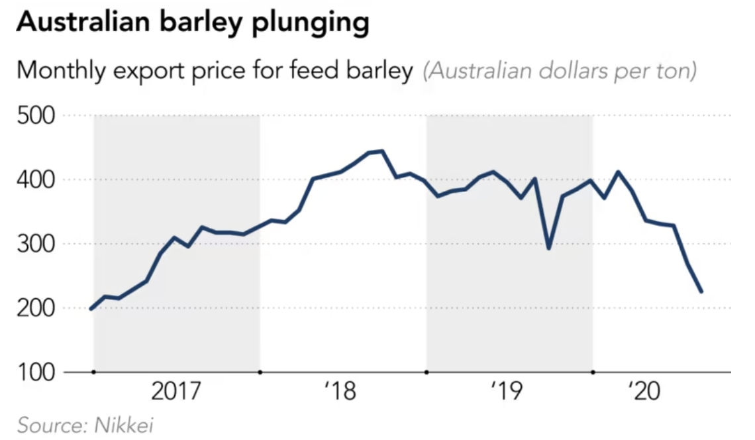
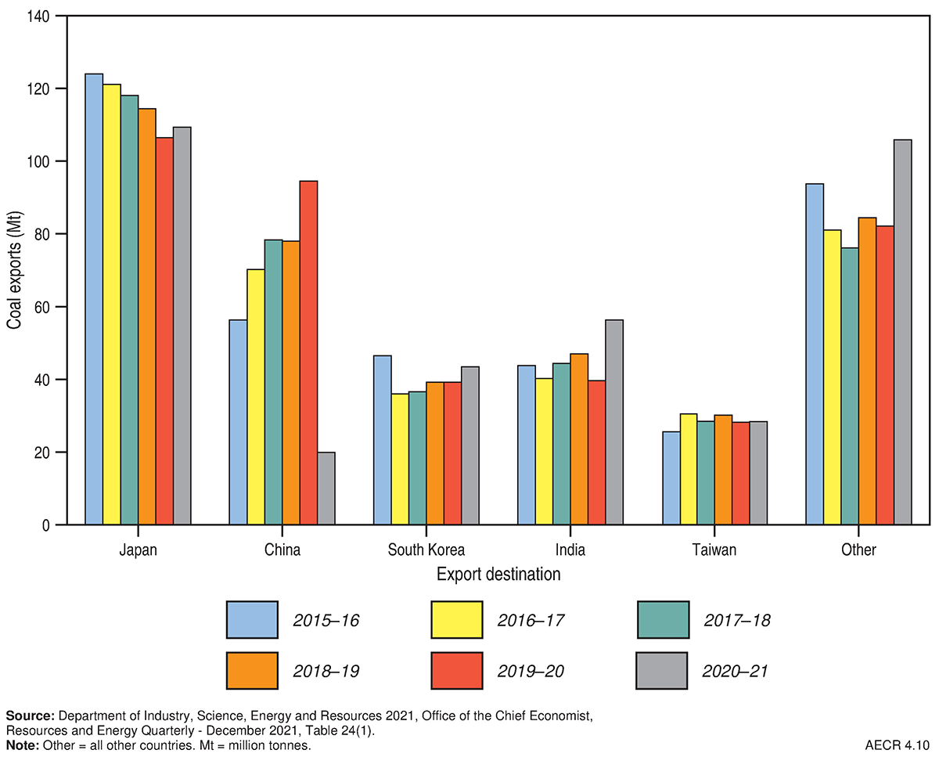
Details of Trade Restriction
Anti-dumping investigation and trade barriers have negative impact on some of Australian commodity prices
Oct 2018 – Anti-dumping investigation
May 2020 – Non - trade barrier on Coal
China started the anti-dumping investigation on Australian barley
In March 2020, there was an 80.5% tariff on Australian barley
Total export worth $1.5 Billion in 2018, $960 million in 2019
Started with administrative difficulties – Australian ships getting docked and awaiting permission
Export value of $13.8 Billion in 2019
No record of import by China since 2020
Source: Geopolitical monitor (2023), Sullivan& Gunders (2020)
Introduction
Event I: 2008 GFC
Event II: Mining Boom
Event III: COVID-19
Event IV: Trade Tension
Outlook & Conclusion

Slide 26
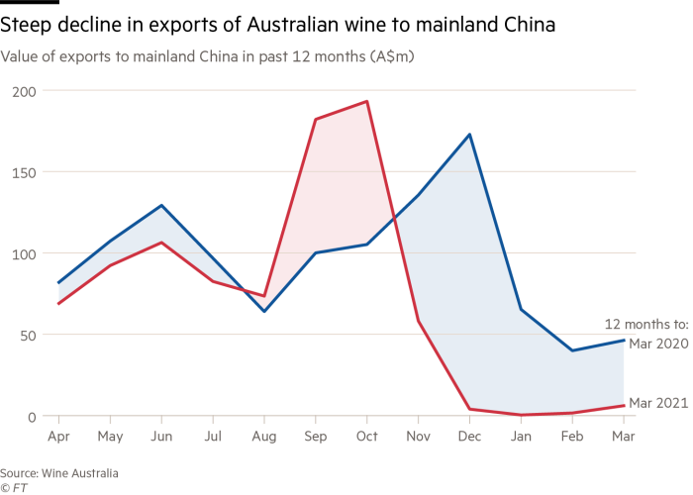
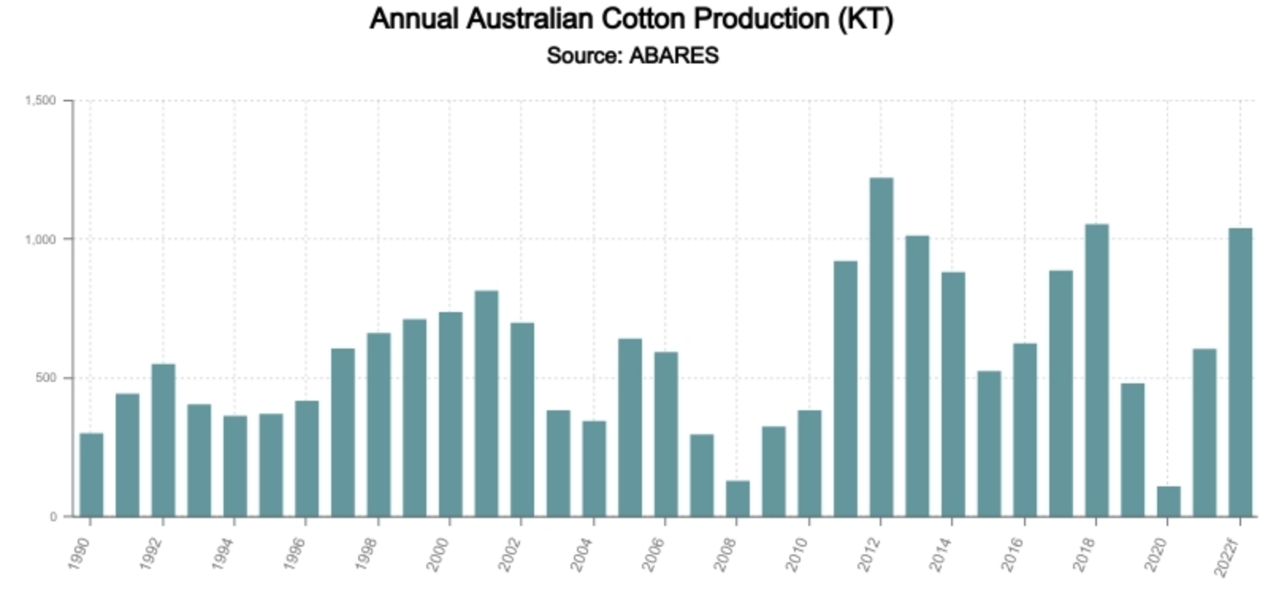
Details of Trade Restriction
More trade barriers by China on Australian export
Oct 2020 – Trade barrier on Cotton
Nov 2020 – Trade barriers on other commodities
Factories in China discouraged by local governments to import cotton from Australia
Threatened with a 40% tariff
Australia usually exports around 65% of cotton to China, with a market value of $800 million
Australia found other destination such as Vietnam but not as profitable
As of Nov 2020, China restricted commodities such as :
Beef (Suspended 4 major beef manufacturers - 35% of beef export)
Wine (Range between 107% - 212%)
Copper, Sugar and Timber
Source: Geopolitical monitor (2023), Sullivan& Gunders (2020), Nikkei (2020)
Introduction
Event I: 2008 GFC
Event II: Mining Boom
Event III: COVID-19
Event IV: Trade Tension
Outlook & Conclusion

Slide 27
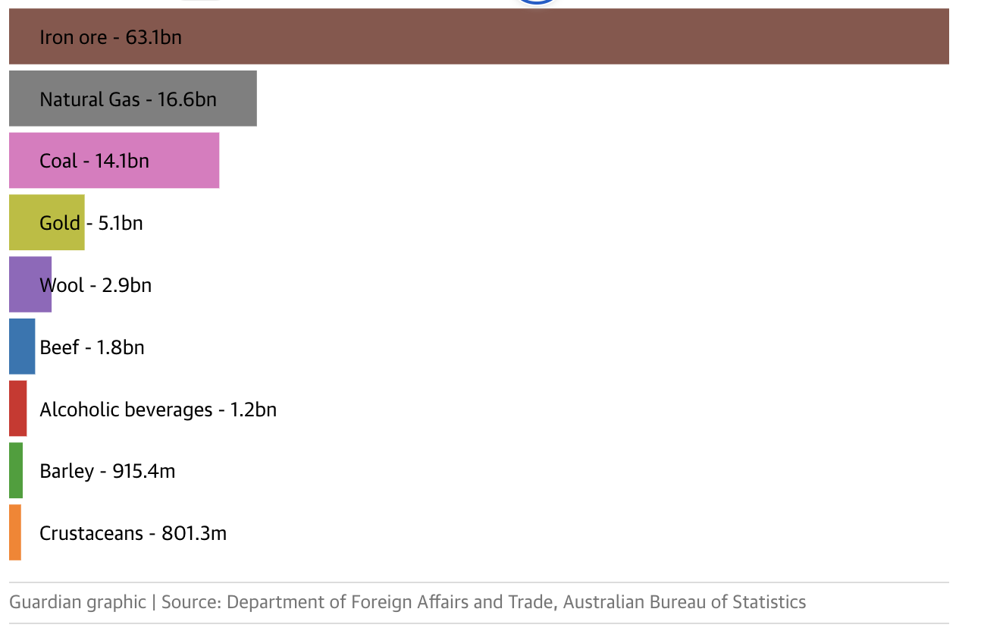
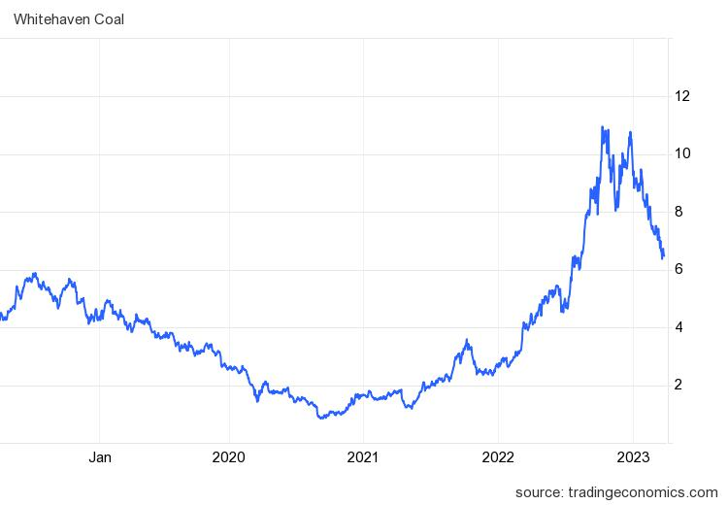
Details of Trade Restriction
Iron export remain strong with hopes of reconciliation
June 2021 – Iron Export
Nov 2022 – Trade ministers meeting
Dec 2020 speculations about tariff on Iron ore
Did not fall through due to China’s heavy reliance on iron ore
June 2021, 80% of export to China was iron ore
Intention to alleviate trade restriction without involving WTO
Usually takes longer time to resolve compared to direct communication
Jan 2023:
China eases restriction on Coal
Source: Trading economics (2023), Guardian (n.d)
Introduction
Event I: 2008 GFC
Event II: Mining Boom
Event III: COVID-19
Event IV: Trade Tension
Outlook & Conclusion

Slide 28
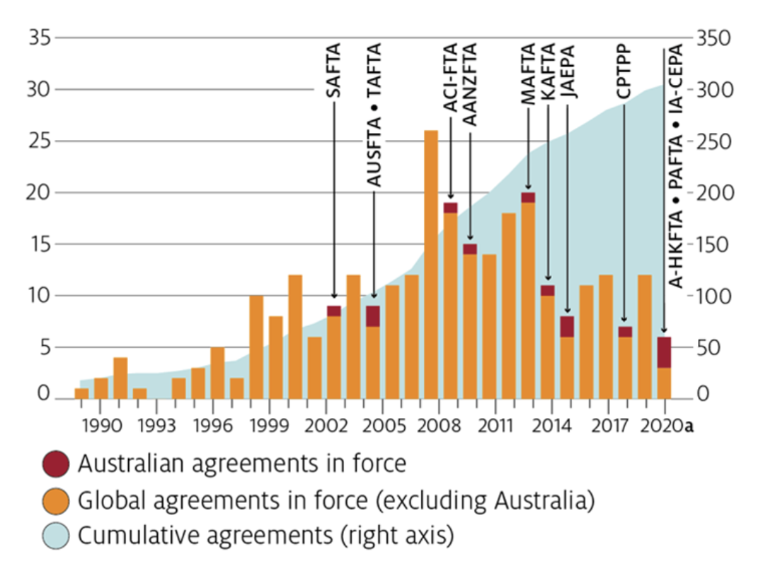
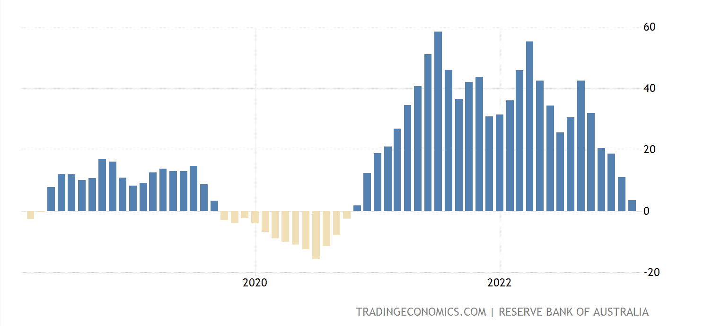
Impact on Australia
Negative impact on export volume for Australia cushioned with new trade agreements
Impact on Australia
Entering new trade agreement
Commodity prices between 2019-2022 declining indicates that export value was also affected
Price can usually explain ¾ of export since 1990
Entered the CPTPP (Comprehensive and Progressive Agreement for Trans-Pacific Partnership.
RCEP (Regional Comprehensive Economic partnership)
Although Australia is included, competitors are also a member and sometimes given better tariffs, so the benefit is limited
Source: Trading Economics (2023),
Introduction
Event I: 2008 GFC
Event II: Mining Boom
Event III: COVID-19
Event IV: Trade Tension
Outlook & Conclusion

Slide 29
Impact on AUS Equities
Fluctuation of the ASX dependent on events
-13%
Persistent decline of the ASX by 13% at the end of 2018 due to anti- dumping
Sharp decline at the start of 2020 due to covid 19 and strained relationship
Chinese government threatened local factories on importing from Australia
Stabilization of ASX as Australia diversified exports
In 2022, trade tension eases
Source: Capital IQ
Introduction
Event I: 2008 GFC
Event II: Mining Boom
Event III: COVID-19
Event IV: Trade Tension
Outlook & Conclusion

Slide 30
Outlook & Conclusion
What lies ahead for the AUS Economy & Equities Market

Slide 31
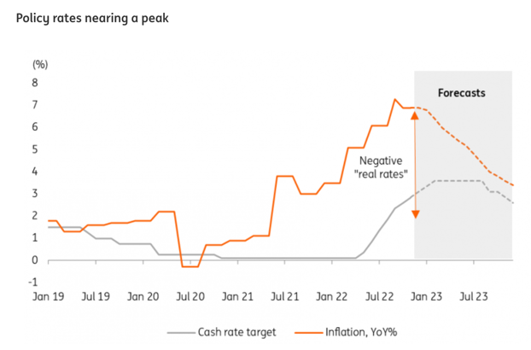
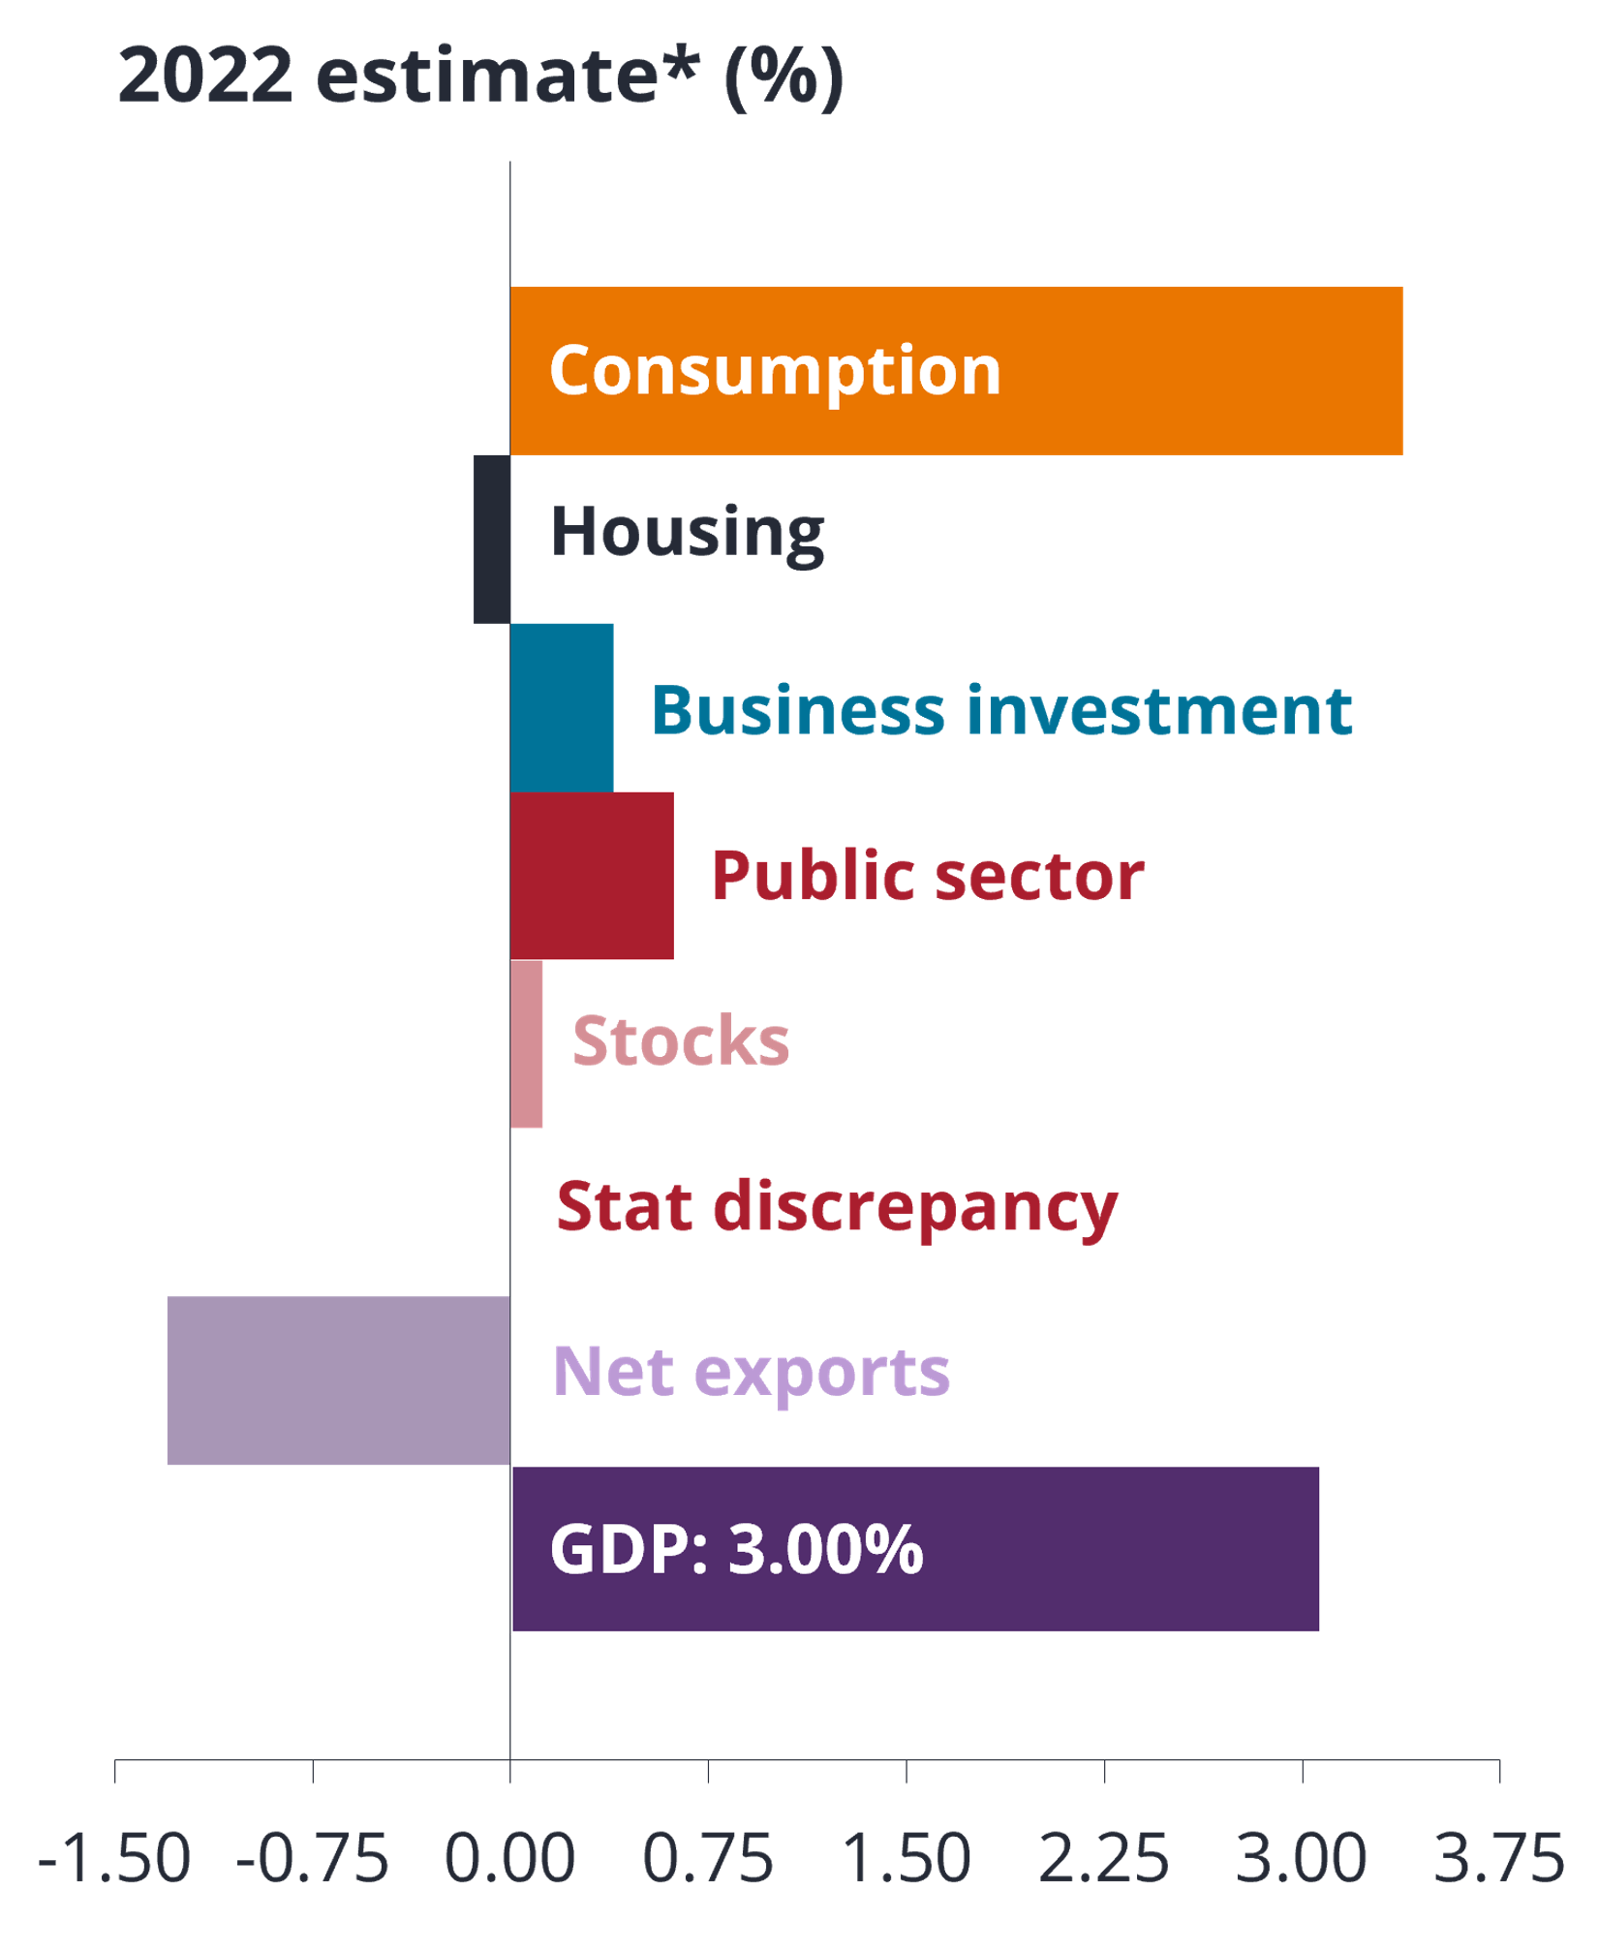

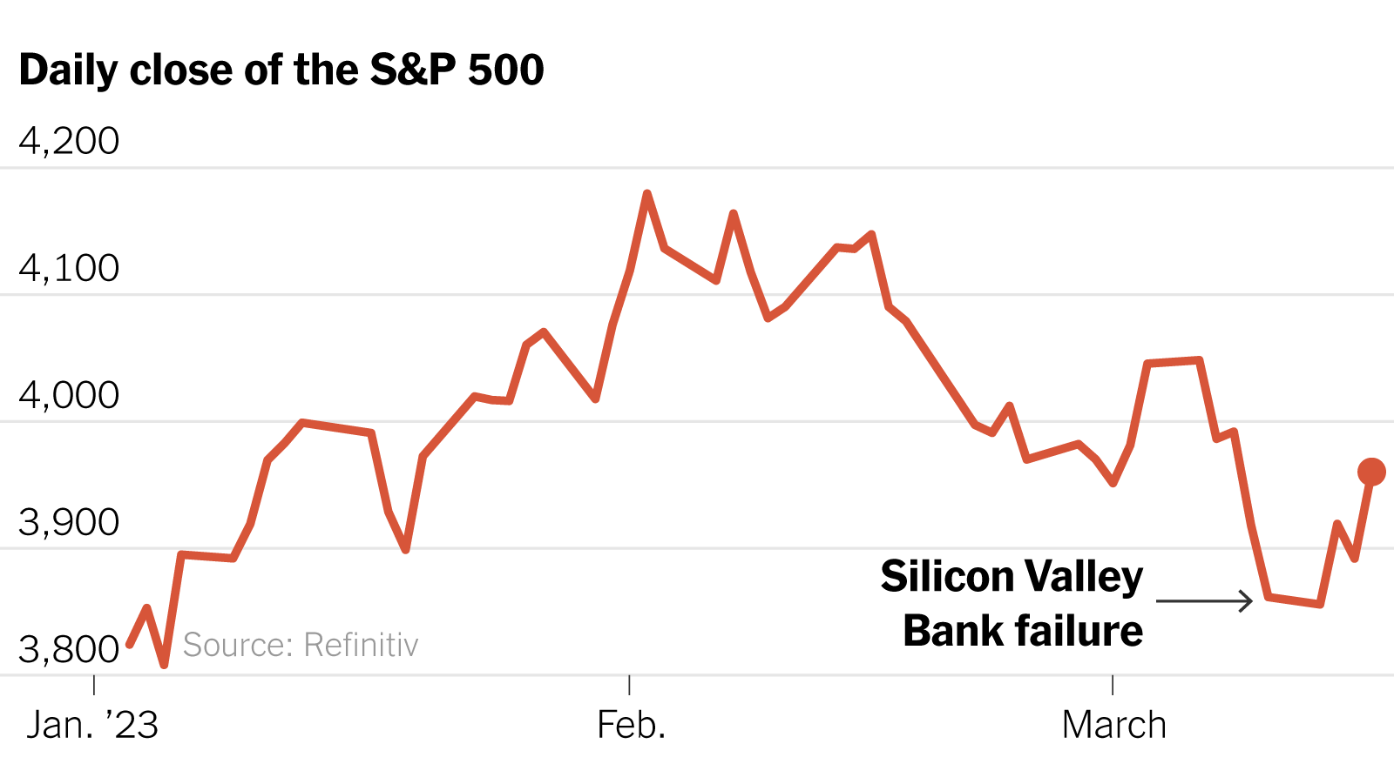
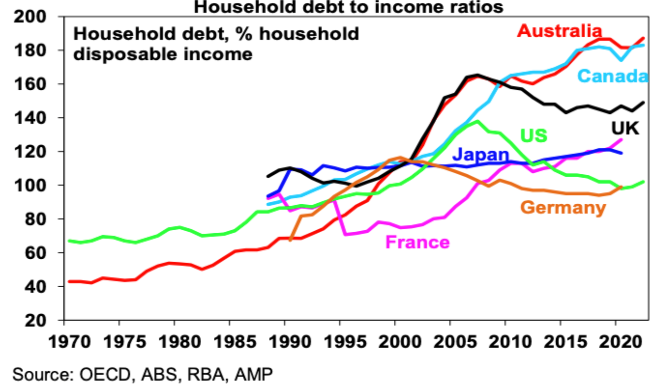
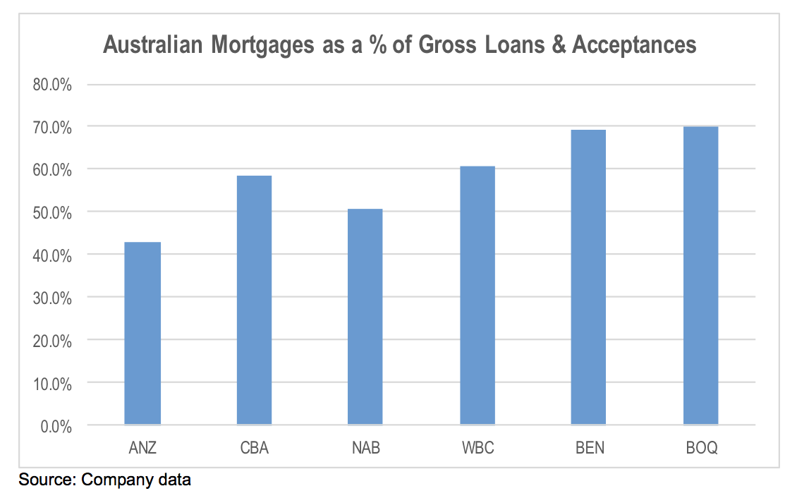

Uncertain Short-term outlook for AU Equities as their Consumer-led Recovery is Rapidly Running out of the Road
Household Consumption as main driver of AUS Economy
Rising Interest & Inflation Rates
Proportion of GDP (%) (2022)
49.9%
Consumer spending is still the biggest portion of AU’s contribution to GDP
However, given current market conditions that affect consumption, this may bring uncertain short-term outlook for AU equities
7 Feb 2023, RBA raised its cash rate for the 9th straight time to a decade-high of 3.35%
325 basis points since May 2022 to hit target inflation rate at 2-3%
Negative effect on Consumption
Housing Crisis – Risk of Housing Market Correction
Global Financial Contagion: Collapse of SVB and CS further dampening Consumer & Business Confidence
Highest household debt growth globally, rising interest rates that have indebted loan payments and banks heavy exposure to mortgage prices
AUS Mortgages as a % of Gross Loans (2022)
-3.0%
-2.5%
Introduction
Event I: 2008 GFC
Event II: Mining Boom
Event III: COVID-19
Event IV: Trade Tension
Outlook & Conclusion

Slide 32
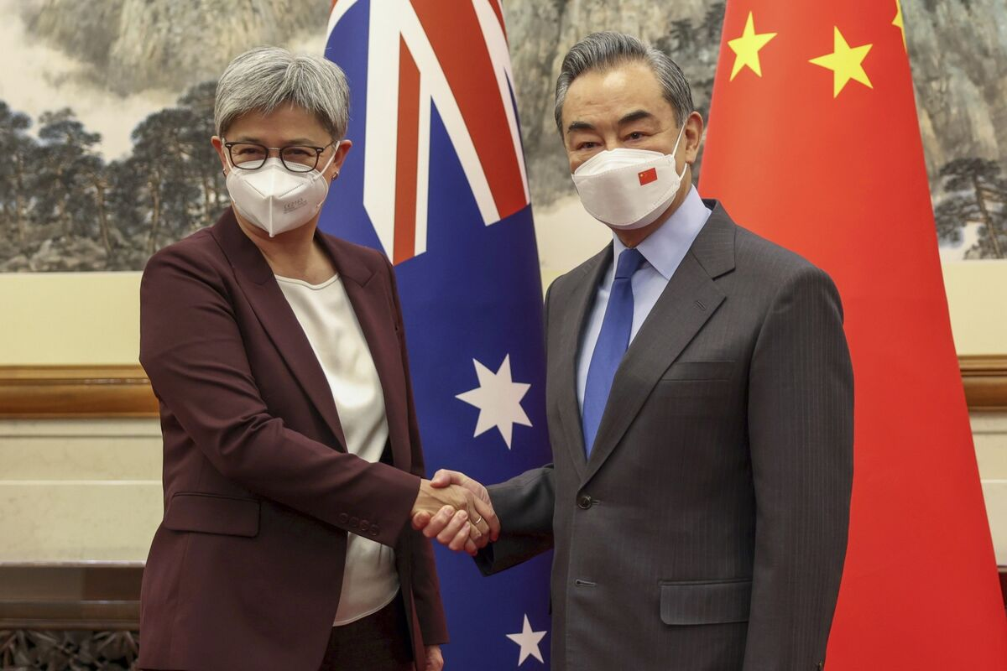
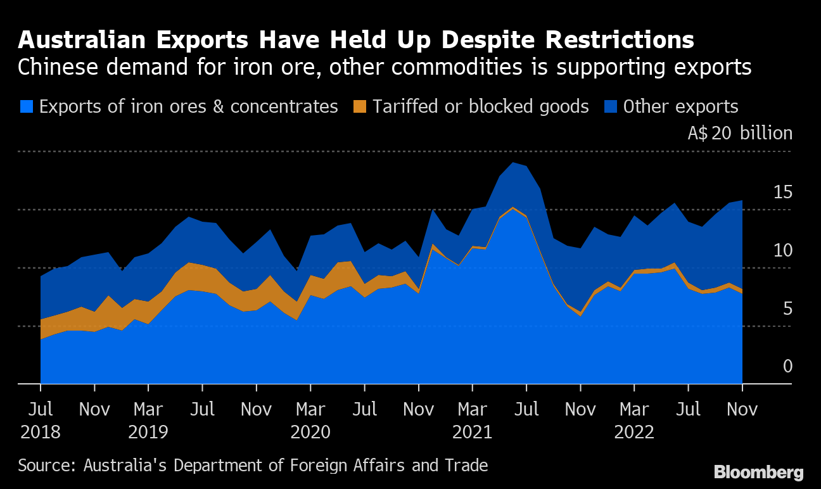




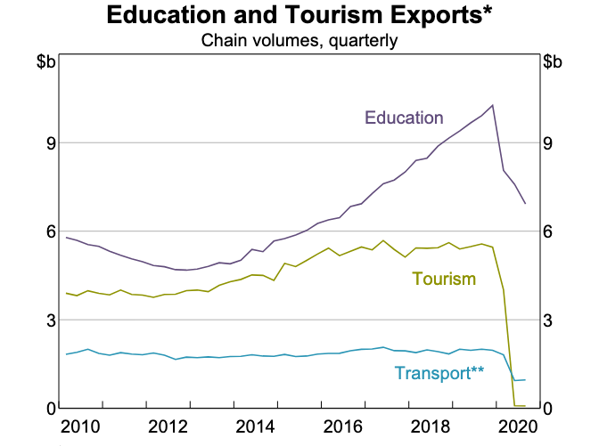


Re-opening of China’s Economy fuels Optimism for AUS Equities as Trade Tensions between AUS and China shows signs of Easing
Easing of AUS – China Trade Tensions
Winners of China’s Re-opening
Australia Commodities (Mining) prices have mounted, taking mining giant shares to record highs
AUS big 3 iron ore miners share prices have risen 30-40% since the news of China’s reopening. Whitehaven Coal saw the most earnings growth and share prices that rose over 300% over late 2022
Export Services – Education & Tourism. Service exports accounted for 20% of total shipment, of this Education made up 40%.
Feb 2023, AUS and China top trade officials met for the first time since 2019, latest signs to thaw diplomatic ties
Expectations that Beijing will soon lift its unofficial restrictions on AUS
Australia reported a fifth consecutive year of trade surpluses and opened 2023 with the enticing prospect of further bolstering overseas shipments as it reheats relations with the world’s second-largest economy
Overall, China’s reopening is expected to boost AUS economy by 1%, with the Australian mining sector's earnings expected to rise over 70%. Of this 1%, a full recovery in Australia's tourism will add 0.5% to its GDP, and the return of Chinese international students will add another 0.4% to the economy
Introduction
Event I: 2008 GFC
Event II: Mining Boom
Event III: COVID-19
Event IV: Trade Tension
Outlook & Conclusion

Slide 33


Concluding Outlook on Impact on AUS Equities: The Lucky Country
Consumption-Driven Economy slowing
Recovery from COVID-19 & China’s Re-opening
Expecting slower economic growth - AUS GDP is expected to grow a mere 1.5% over 2023 from 3.5% in 2022
Resilient economy also known as ‘The Lucky Country’ who will benefit substantially from factors above
Short-Term
Med - Long-Term
Effect of rising interest & inflation rates & current banking sector volatility: Goods consumption have fallen 1% in the quarter of 2023 led by falls in discretionary items like clothing & footwear and household goods, hotels, cafes and restaurants
Decrease in consumption can decrease corporate sales and corporate earnings, thus decreasing the value of individual stocks esp. in the consumer discretionary sector
Overweight on AUS equities in the long-run, especially on the energy and mining sectors.
We believe these will out-perform market expectations given the attractiveness in current valuations owning to increasing commodity prices and commodity export windfalls, strong demand and underinvestment in supply
Overall, AUS economy will weigh heavily on the Reserve Bank’s monetary policy outlook for the coming years ahead in tackling their current interest and inflation rate hikes as well as the confirmation of trade tensions to ease so that AUS can fully capitalize on China’s reponing
Introduction
Event I: 2008 GFC
Event II: Mining Boom
Event III: COVID-19
Event IV: Trade Tension
Outlook & Conclusion

